Slide 1
May 7, 2019 | Washington, DC

Slide 2
Welcome

Slide 3
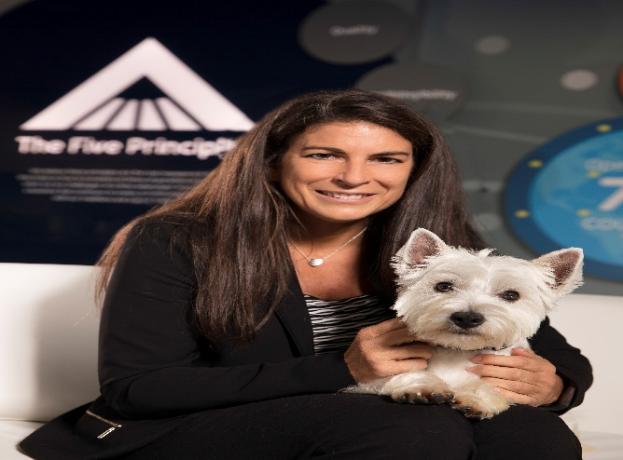
Rena Crumplen, Mars Petcare

Slide 4
Welcome

Slide 5
Pamela Mars Wright

Slide 6
Collette Bunton, Whistle

Slide 7
May 7, 2019 | Washington, DC

Slide 8
Steven Feldman, HABRI

Slide 9
Purpose & Vision for the Social Isolation & Companion Animals Summit

Slide 10
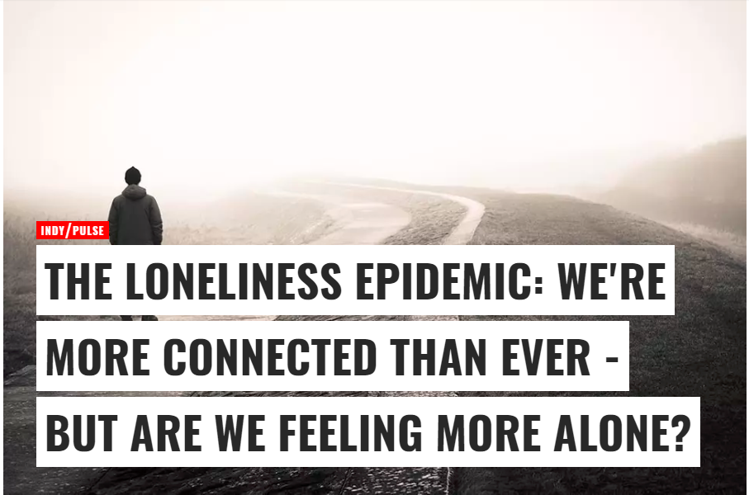
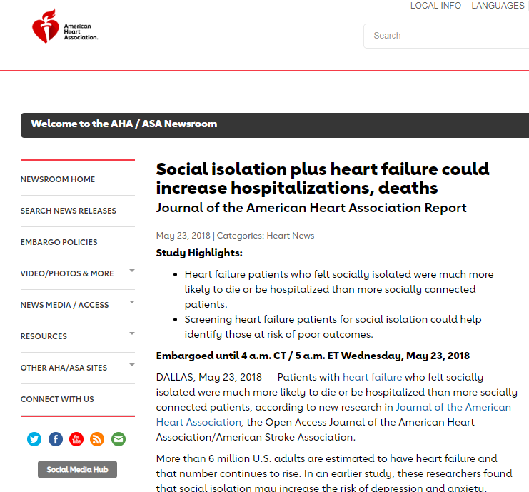
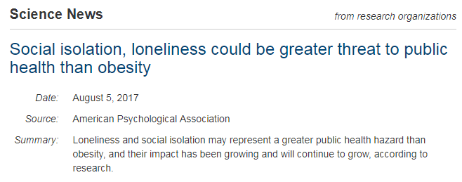
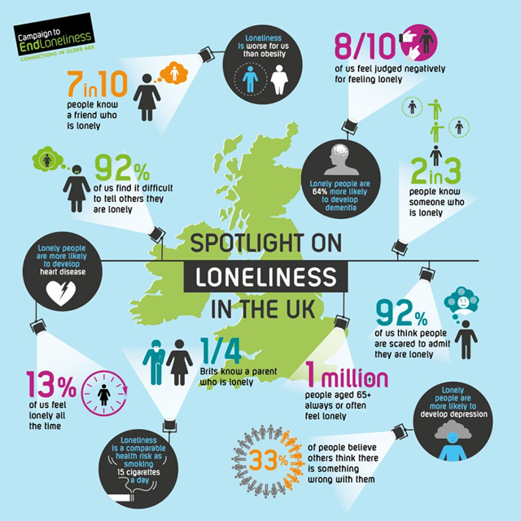
Loneliness and Social Isolation

Slide 11
Loneliness and Social Isolation in Society
According to the AARP Foundation, social isolation affects more than 8 million age 50-plus adults and is growing as 10,000 Americans a day turn 65.
Approximately 1/3 of Americans older than 65 live alone, and half of those over 85 do.
According to the National Council on Aging, an estimated 17% of all Americans over the age of 65 are isolated because they live alone and face one or more barriers related to geographic location, language, or disability.
People with poorer health – particularly those with mood disorders like anxiety and depression – are more likely to feel lonely.

Slide 12
Health Impacts of Social Isolation and Loneliness
Loneliness is a major risk factor for depression, which accelerates decline and increases mortality.
The strength of social isolation as a predictor of mortality is similar to that of well-documented clinical risk factors, such as smoking and high blood pressure.
Research indicates that loneliness is a risk factor for, and may contribute to, poorer overall cognitive performance, faster cognitive decline, poorer executive functioning, increased negativity and depressive cognition, heightened sensitivity to social threats, a confirmatory bias in social cognition that is self-protective and paradoxically self-defeating.
Social relationships – both quantity and quality – affect mental and physical health. Adults who are more socially connected are healthier and live longer than their more isolated peers.

Slide 13
Pet Ownership and Human-Animal Interaction
85% of respondents agree interaction with pets can help reduce loneliness
76% agree human-pet interactions can help address social isolation
72% believe human-animal interaction is good for their community
89% of pet owners who got a pet for loneliness felt that their pet helped them feel less lonely
Survey of 1,469 U.S. pet owners and 567 non-owners conducted by Edelman Intelligence, December 2018, MoE + 5%

Slide 14
Pet Ownership and Human-Animal Interaction
97% of doctors believe there are health benefits that results from owning a pet
60% of doctors have recommended getting a pet to a patient
#1 Reason: Loneliness
Survey of 1,000 family doctors and general practitioners conducted by Michael Cohen Group, August 2014, MoE + 3.1%
There is widespread agreement that pets can help address the societal challenge of loneliness and social isolation

Slide 15
Shared Mission
Advance scientific research, best practices and practical solutions to facilitate the vital role of human-animal interaction in addressing the crisis of social isolation and loneliness in society
+

Slide 16
Summit Framework
Scientific Research
Identify future directions and advance high-quality scientific research that can inform practice
Best Practices
Share information and programs happening now, safeguarding the well-being of people and animals
Barriers/Practical Solutions
Support more healthy interaction and a strong human-animal bond

Slide 17
Summit Format
Share Information
Experts Panels:
Older Adults, Social isolation, Loneliness and the Role of Companion Animals
People with Mental Health Challenges, Social isolation, Loneliness and the Role of Companion Animals
Stakeholder Questions/Discussion

Slide 18
Thank you to our Sponsors

Slide 19
May 7, 2019 | Washington, DC

Slide 20
Dr. Vivek H. Murthy, MD, MBA 19th Surgeon General of the United States

Slide 21
Social Isolation, Loneliness and Public Health

Slide 22
Morning Break

Slide 23
May 7, 2019 | Washington, DC

Slide 24
Section 1: Overview of Social Isolation, Loneliness & Human-Animal Interaction (HAI)

Slide 25
Layla Esposito, PhD Eunice Kennedy Shriver National Institute of Child Health & Development, National Institutes of Health

Slide 26
HAI Research and the NICHD-Mars/Waltham Public-Private Partnership
May 7, 2019
Layla Esposito, Ph.D.

Slide 27
NIH/Mars-Waltham Public Private Partnership (PPP)
Formal partnership began in 2008 to explore the scientific evidence base and promote research in Human-Animal Interaction (HAI) research
Specific areas of interest include
Impact of HAI on typical and atypical child development and health
The evaluation of animal-assisted intervention for children and adults with disabilities or in need of rehabilitative services
The effects of animals on public health, including cost effectiveness of involving animals in reducing and preventing disease
Notes:
The National Survey of Children’s Health (NSCH) examines the physical and emotional health of children from birth to 17 years. The NSCH was designed to produce nationally- and state-representative estimates.
Newly added measure of Adverse Family Experience, measuring individual, family, and neighborhood stressors. AFE questions: perceived discrimination, death of a parent, witness/victim of neighborhood violence, socioeconomic hardship. ACE questions: divorce/separation, parent time in jail, witness to domestic violence, living with someone with mental illness or suicidality, lived with someone with a drug problem
The previous version of the NSCH was conducted three times between 2003 and 2012. In 2003, 2007, and 2011/12, the NSCH was conducted using telephone methodology, and was conducted by the National Center for Health Statistics at the Centers for Disease Control under the direction and sponsorship of the federal Maternal and Child Health Bureau (MCHB) of HRSA.

Slide 28
NIH/Mars-WALTHAM Public-Private Partnership
Joint activities include:
Co-funding grants
Publishing books & journal special issues
Hosting workshops, conference panels & consortium meetings for funded researchers
Developing HAI resources
Notes:
28
NIH=National Institutes of Science
NICHD=National Institute of Child Health & Human Development
HAI=Human Animal Interaction
NIH has annual budget of $29billion
NICHD is a medium sized NI with a budget of about $1bn
Late 2007, we began conversations with NICHD about the importance of human-animal interaction, in particular to child development and health.
While there are various aspects of HAI that could be explored, as a first step, we have focused on the interface between HAI and child development.

Slide 29
Partnership workshops
Directions in HAI Research: Child Development, Health, and ​Therapeutic Interventions workshop (2008)
Role of Pets in the Socio-emotional and Bio-behavioral Development of Children (2009)
Social Neuroscience of Human-Animal Interactions (2011)
Animal-assisted Interventions in Special Populations (2015)

Slide 30
HAI grants
Efforts from the partnership have resulted in nearly 40 NIH grants in HAI research (R03s, R21s, R01s)
Examples of currently funded studies:
Longitudinal cognitive and emotional development in working dogs
(PI: Brain Hare)
Oxytocin pathways and the health effects of human-animal interaction
(PI: MacLean)
Effects of therapy dogs on social behavior in group skills instruction with children with autism (PI: Protopopova)
Quantifying the efficacy and role of service dogs for military veterans with PTSD and their spouses (PI: O’Haire)

Slide 31
Growth and progress in the field
Significantly improved rigor in methodology and design in research studies
Expansion in breadth of topics under investigation; moving beyond correlation to mechanism
Increase in quality, peer-reviewed publications in a diverse range of journals
New HAI journals: e.g., Human-Animal Interaction Bulletin, Applied Developmental Science- HAI focal area

Slide 32
Growth and progress in the field
Increased HAI funding streams for research
NIH, Mars/Waltham, HABRI, Horses & Humans Foundation, etc.
Increased recognition of HAI at scientific conferences (e.g., APA, SRCD)
Creation of new HAI centers or programs at academic institutions
At least 7 new centers in the past decade, such as:
Tufts Institute for Human-Animal Interaction
Human-Animal Interaction Research Initiative (University of Arizona)
Center for Animal and Human Relationships (Virginia Tech)
Establishment of HABRI
Furthering science, education and advocacy around the role of companion animals

Slide 34
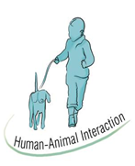
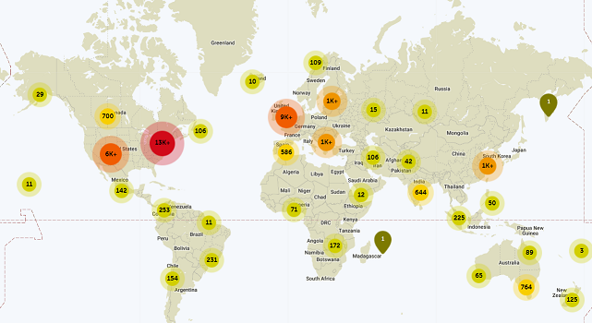
Frontiers Research Topic: Human-Animal Interaction (HAI) Research: A Decade of Progress
Series of articles that highlights the NIH-Mars PPP and provides an overview of research supported by the partnership over the past decade (edited by members of the PPP)
Highlights a wide range of topics in HAI from social-emotional, behavior and biological effects of HAI to cohort data to ideas for future directions and new methodologies
Articles published between Oct 2018 – April 2019
but already a large impact!
39,352 total views to-date
Over 2,500 downloads
Global interest

Slide 35
Thank you for your attention!
Layla.Esposito@nih.gov

Slide 36
May 7, 2019 | Washington, DC

Slide 37
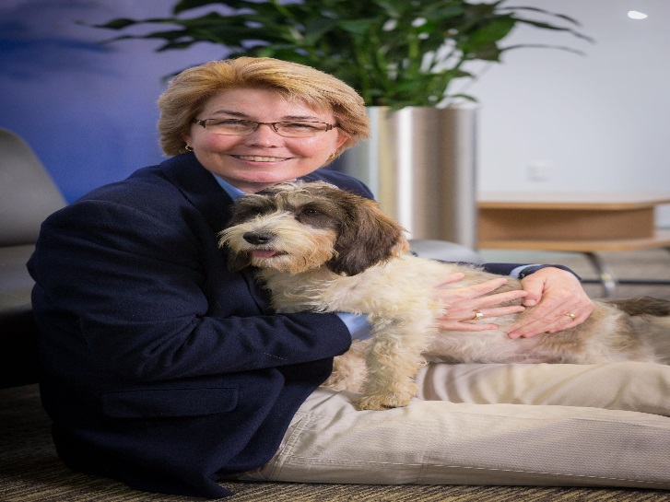
Nancy Gee, PhD State University of New York at Fredonia HAI Research Manager, Mars – WALTHAM Centre for Pet Nutrition

Slide 38
Loneliness – The Potential for Pets
Nancy R. Gee, PhD
Professor of Psychology
State University of New York, Fredonia
WALTHAM Human-Animal Interaction Research Manager

Slide 39
WALTHAM: fundamental research for Mars Petcare
www.waltham.com
Notes:
WALTHAM® is a leading global authority on pet nutrition and well-being, combining companion animal expertise with fundamental research to generate knowledge and insights that drive A Better World for Pets®. WALTHAM’s research hub is the WALTHAM Centre for Pet Nutrition, which is the global fundamental science centre for Mars Petcare.
Our research and animal care facilities are situated in the heart of the UK and our multidisciplinary team work with Universities and institutes globally to carry out research in the areas of pet nutrition and related sciences (e.g. digestive, oral health and flavour chemistry).
Our research is incorporated into Mars Petcare brands such as Pedigree, Whiskas, Royal Canin and Nutro and supports our vision for A Better World for Pets.
To find out more about WALTHAM and our research please visit WALTHAM.com

Slide 40
Based on HAI research,
why do we think pets might ameliorate loneliness?

Slide 41
We are social creatures
Dogs emerged from wolves by adapting to human social demands over a period of at least 35,000 years (Frantz et al., 2016)
There is probably no other species on the planet as well matched to human social needs as dogs (Miklosi, et al., 2004).

Slide 42
We need to connect with attachment figures…
Pets fulfill the four roles of an attachment figure (Ainsworth, 1989):
Enjoyable
Comforting (Bonas et al., 2000)
Missed when absent (Archer & Winchester, 1994)
Sought in times of distress (Kurdek, 2009)
People report turning to their pets for love and support (Rynearson, 1978)
Adolescents derive more satisfaction from, and engage in less conflict with, their pets than their siblings (Cassels et al., 2017)

Slide 43
We need someone to talk to…
50% of adults and 70% of children report confiding in their pets (Katcher & Beck, 1987)
No need to worry about:
Confidentiality, reprisals, judgments or meeting expectations (Melson, 2001)
Talking to pets, compared with talking to people, is associated with lower cardiac responses (Lynch, 1985)

Slide 44
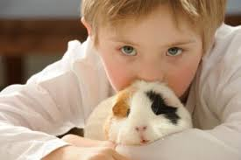
We need someone to talk to…
Patients with language disorders improve verbalizations (Adams, 1997; LaFrance, Garcia & Lebreche, 2006)
Children on the autism spectrum show increased social interactions and skills:
More talking, smiling and laughing with others (O’Haire et al., 2013)
More language output and greater verbal fluency (Gabriels, et al., 2015)
Less solitary play and more engagement with peers (Ward, et al., 2013)

Slide 45
Social Competence and Adjustment
Interacting with animals linked to the development of:
Self-awareness
Social awareness
Self-management
Relationship skills
Responsible decision making
Ability to read non-verbal cues such as facial expressions and body language
Pendry, Carr & Vandagriff (2017)

Slide 46
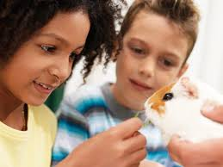
Pets as social “icebreakers”
People will “risk directly engaging” with unfamiliar people when there is a pet present (Newby, 1997).
Pets are the “great leveler” (Serpell, 2011)
When people with disabilities are accompanied by a service dog they experience:
More social greetings from adults and children
More approaches by other people
Greater willingness to go out in the evenings
Hart, Hart & Bergin (1987)
Notes:
Great leveler - transcending social boundaries – race, culture, geography, age, politics, socioeconomic status

Slide 47
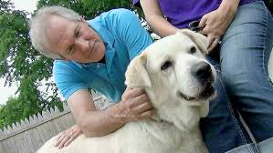
Social Capital
Reciprocity – perceived willingness to help someone else
Pets precipitate the exchange of favors (Wood, et al., 2007)
Pet owners report giving/receiving more neighborhood favors
Civic Engagement
pet owners are more likely to be concerned about and active in their communities (Wood, et al., 2005)

Slide 48
Social Capital
Fostering Trust
Pet owners are more likely to agree that people can be trusted
Building Social Networks
Pet owners report that they have gotten to know people and made friends through their pets
Getting out in the community
Dogs motivate people to get out and go for a walk
Higher levels of walking and physical activity among dog owners
Wood, et al., 2005; McHarg, et al., 1995; Cutt, et al., 2008
Notes:
Visible presence of dog walkers in a community has emerged as an indication of neighborhood safety, - “eyes on the street” creates a perception of community safety.
Women who walk with dogs feel safer when walking than women who do not walk with dogs.

Slide 49
Consortium Steering Committee Meeting
Notes:
In September we brought together experts in the areas of HAI and Social Isolation and Loneliness.
We discussed a number of things including the current state of research in the intersection of these areas as well as best practices for AAI and arrived at two topical areas that we deemed to provide the most fertile ground for immediate exploration.
You’ll see that our agenda is divided up in such a way that we will focus on both topics. I’d like to provide an overview of the research in both topical areas to give our discussion a bit of background.

Slide 50
Topic #1 - Older Adults
Special Issue on HAI in Healthy Human Aging
https://www.tandfonline.com/toc/rfan20/32/2
The potential of companion animals to:
Enhance diminishing social networks
Maintain physical and cognitive functioning
Improve quality of life

Slide 51
Reviewed 145 Studies
Evaluated Quality of Evidence

Slide 52
Findings for Pet Ownership (N=13 studies)
The less robust studies report that pet attachment:
was associated with reduced loneliness in older adults
mediated the relationship between loneliness and health
was viewed as a coping resource for loneliness
The higher quality studies (5 of 7) tended to report null results or a negative relationships – Two positive results:
Individuals over 60 who live alone reported their
pets as particularly effective in attenuating loneliness
Higher pet attachment related to less loneliness

Slide 53
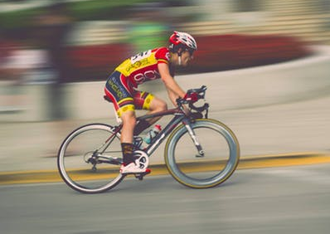
Does pet ownership fail to ameliorate loneliness?
Very unlikely!
Researchers need to consider how we look at pet ownership
As is, it is a blunt measure subject to selection bias.
People like to select their own pets
Pet interaction/involvement instead

Slide 54
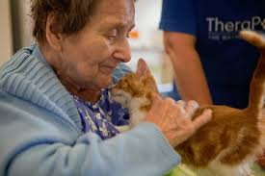
Findings for AAI (N=32 studies)
More available, and stronger, evidence!
Most studies report positive effects of AAI on loneliness, social behaviors or social interactions
Solid evidence that pets can make a difference in this space!

Slide 55
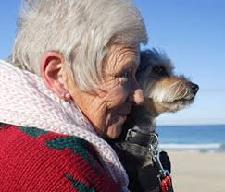
Topic #2 – Mental Health
Depression is the most common psychological disorder in Western Society.
Major cause of morbidity worldwide!
Particularly relevant for older adults
Decreasing social networks
Physical health problems
Increasing levels of anxiety
Wells 2019

Slide 56
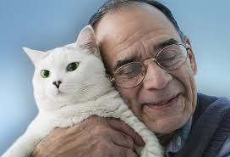
Depression - Older Adults
Pet Ownership – Findings are mixed
Older bereaved adults who owned a pet experienced less depression following their loss – recent work supports this finding
Other studies have found no relationship
One study found that pet owners were twice as likely to have suffered from depression at some point in their lives
People may self-medicate for depression by acquiring a pet.
Gee & Mueller (2019)

Slide 57
Depression – Older Adults
AAI findings are more consistent and evidence is stronger!
A gold standard study – randomly assigned an animal to people, used standardized measures
Found reductions in depression and improvement in measures of cognition in the animal condition
Most of the studies link AAI to decreases in depression in older adults.
Ko, et al., 2016; Gee & Mueller, 2019

Slide 58
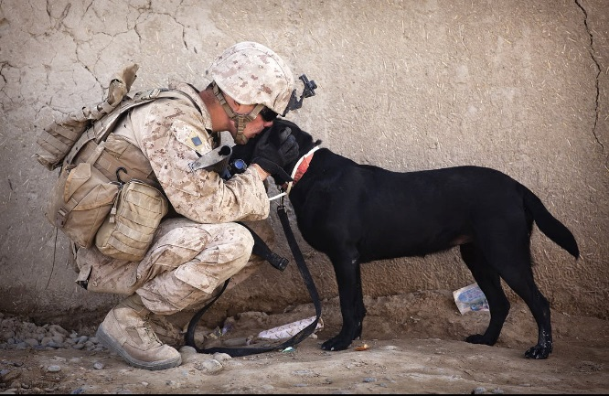
Other Mental Health Topics
Trauma
Systematic Review (O’Haire et al., 2015)
AAI associated with reduced depression, PTSD symptoms, and anxiety
Youth at risk for mental health problems
Systematic review (Hoagwood, et al., 2017)
Positive effects associated with:
Equine therapies for autism
Canine therapies for childhood trauma

Slide 59
Pets and Mental Health
Common theme in the literature –
AAI have promise as a complementary/adjunct treatment for many mental health issues
Pet ownership is likely to impact mental health issues, but a more elegant approach is required

Slide 60
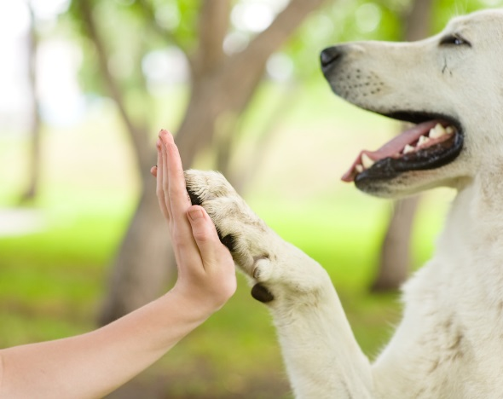
Where does all of this leave us?
Results are heavily weighted in favor of a positive impact of pets on aspects of loneliness
Many unanswered questions:
What works?
Important aspects of intervention?
Dosage?
Time course of effects?
Populations most likely to benefit?
Role of Pet Ownership/Interaction history?

Slide 61
The future is bright!
We have an encouraging foundation of evidence on which to build!
Particularly in AAI
Ample opportunity to more clearly examine pet ownership/interaction going forward
The available science indicates that pets can and probably do play a role in ameliorating loneliness
It’s time to move forward!

Slide 62
Thank You
Any questions?

Slide 63
May 7, 2019 | Washington, DC

Slide 64
Section 2: Older Adults, Social Isolation, Loneliness & Companion Animals

Slide 65
Pets and Older Adults
9 in 10 people aged 55+ believe pets can help older adults feel less lonely
Survey of 1,469 U.S. pet owners and 567 non-owners conducted by Edelman Intelligence, December 2018, MoE + 5%

Slide 66
Why are Social Isolation & Loneliness Particularly Problematic for Older Adults?

Slide 67
Chelsea Gilchrist, MGS National Council on Aging (NCOA)

Slide 68
May 7, 2019 | Washington, DC

Slide 69
Social Isolation and Loneliness Among Older Adults May 7, 2019 Chelsea Gilchrist, MGS Senior Program Manager, Center for Healthy Aging National Council on Aging

Slide 70
About NCOA
Who We Are: NCOA is the national voice for every American’s right to age well
Our Mission: Improve the lives of millions of older adults, especially those who are struggling

Slide 71
How We Accomplish Our Mission
Innovative Programs: NCOA’s online and in-community programs empower individuals to take small steps that can significantly improve their daily lives.
Advocacy: NCOA works in a bipartisan manner to protect and improve federal programs that Americans depend on, like Medicare, Medicaid, and the Older Americans Act.
Partnerships: NCOA supports a national network of local partners that provide personalized services to help individuals stay healthy and economically secure as they age.

Slide 72
NCOA’s Center for Healthy Aging
Goal: Increase the quality and years of healthy life for older adults and adults with disabilities
Two national resource centers funded by the Administration for Community Living
Chronic Disease Self-Management Education
Falls Prevention
Other key areas: Social connectedness, behavioral health, physical activity, immunizations, oral health

Slide 73
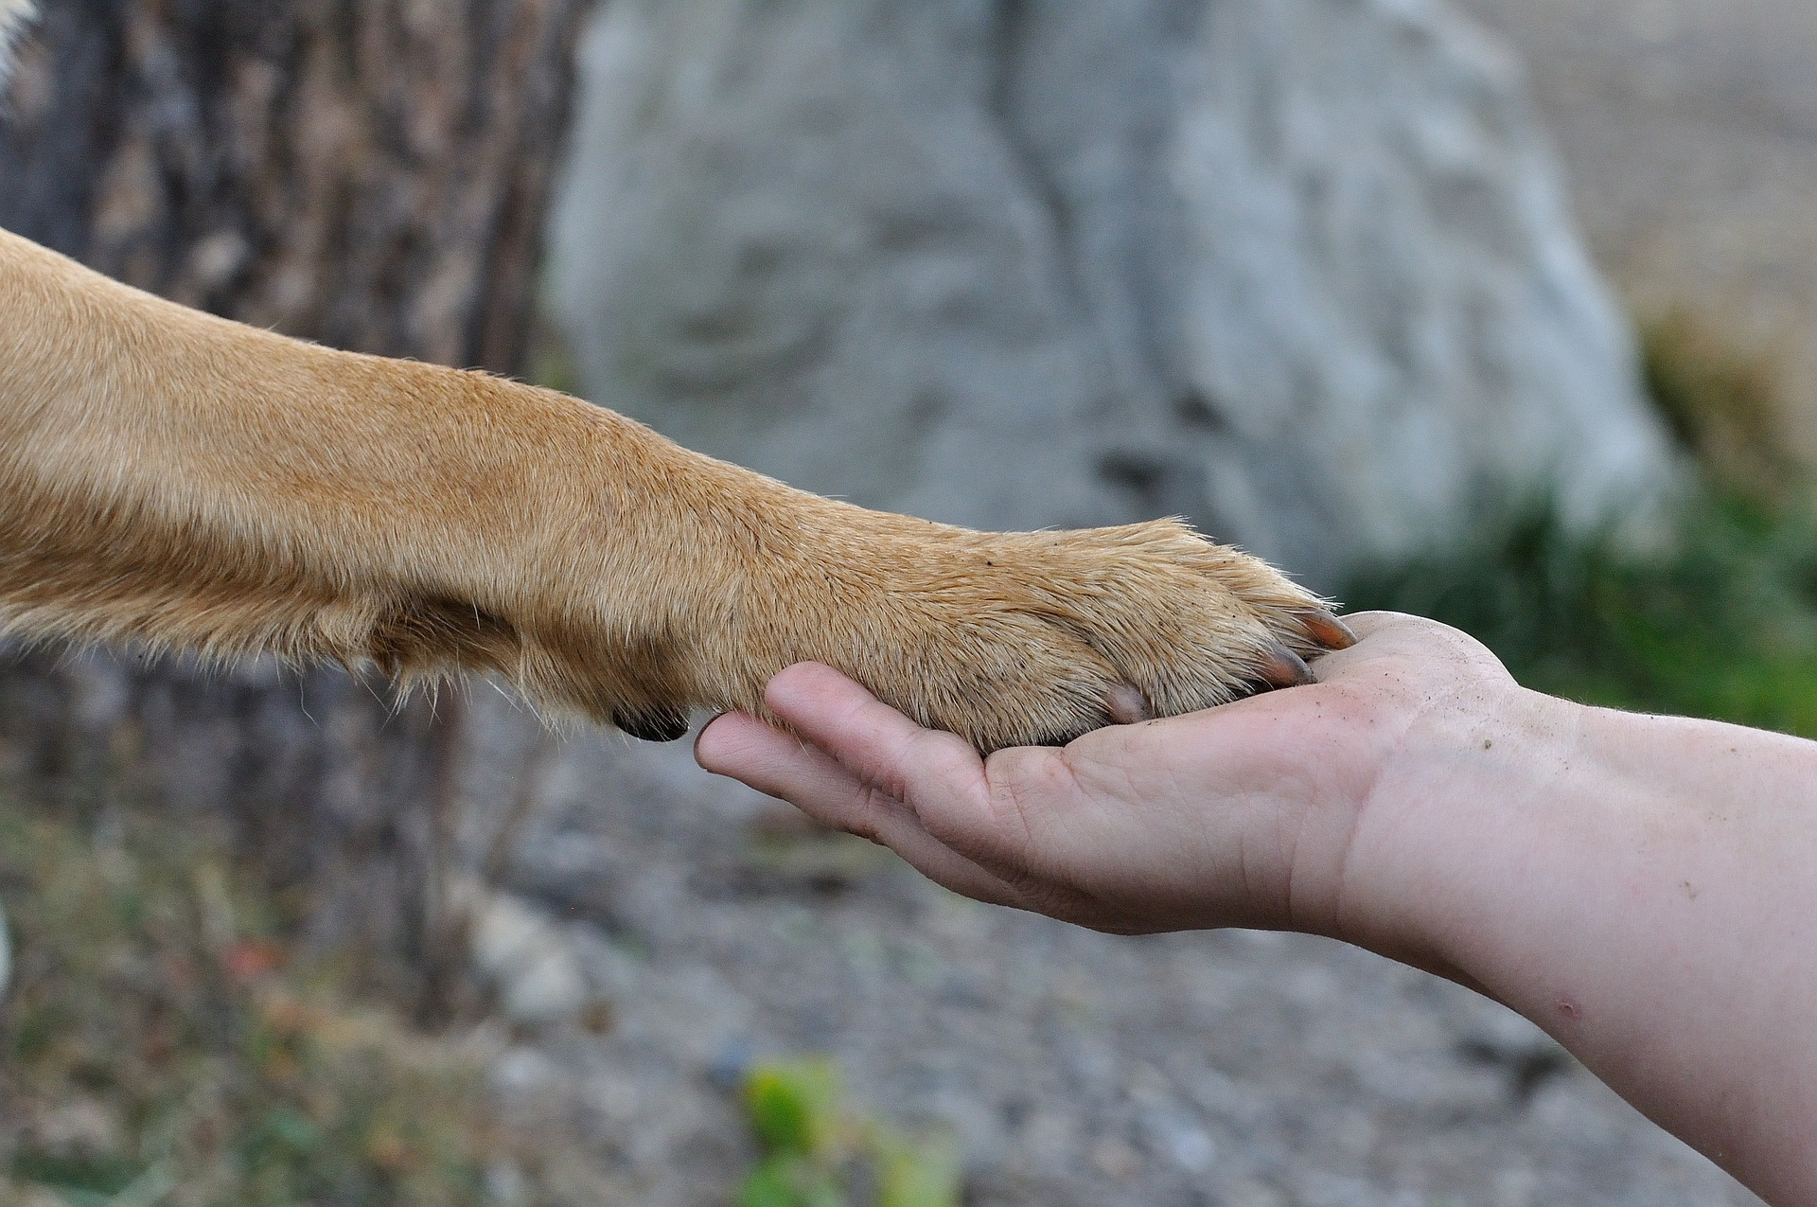
Connection gives purpose and meaning to our lives

Slide 74
Overview
Prevalence of Social Isolation and Loneliness Among Older Adults
Health and Financial Implications
Predictors
Promising Practices and Interventions
Looking Ahead

Slide 75
International Recognition of Social Isolation & Loneliness
World Health Organization recognizes the growing issue of social isolation as a determinant of health
United Kingdom Campaign to End Loneliness
25% of UK adults age 65+ feel lonely
Loneliness New Zealand
10% of New Zealanders age 50+ feel lonely all or most of the time
Japan Kodokushi
21% of Japanese adults age 65+ feel lonely
Canada Reach Isolated Seniors Everywhere (RISE) Initiative
One in six older Canadians are socially isolated

Slide 76
43% of Americans age 60+ feel lonely
32% lack companionship
25% feel left out
18% feel isolated
Perissinotto et al., 2012
Notes:
43% of adults age 60+ feel lonely
32% lack companionship
25% feel left out
18% feel isolated
.
Reference: Perissinotto CM, Stijacic Cenzer I, Covinsky KE. Loneliness in older persons: a predictor of functional decline and death. Arch Intern Med. 2012;172:1078-1083.
Age 60+, in 2015:
This is a 6 year prospective study using participants in the 2002 Health and Retirement Study (HRS). The HRS is a population-based longitudinal study examining the relationships between health and wealth changes as people age. Number of participants (all age 60+)=1604 participants who completed a 3 question loneliness scale: whether subjects feel left out, isolated, or lack companionship
43.2% participants reported feeling lonely defined as reporting one of the loneliness items at least some of the time. In the 3-item loneliness questionnaire:
32% reported lacking companionship,
25% reported feeling left out, and
18% reported feeling isolated at least some of the time.
Subjects who were lonely were slightly older (71.3 vs. 70.5) and were less likely to be white. Subjects were also more likely to be female, had lower SES across all measures, were more likely to smoke, have most comorbid conditions, have greater baseline functional impairment, have sensory impairments, and were less likely drink alcohol, engage in frequent physical activity

Slide 77
35% of Americans age 45+ feel lonely
AARP National Survey, 2018
Notes:
Age 45+, In 2018:
35% of U.S. adults age 45 and older are lonely; approximately 47.8 million older adults
41% report feelings of loneliness/isolation for 6+ years
70% report there was not a single incident that led to feelings of loneliness
Of those who identify as lonely, 4 in10 (or 41%) report that feelings of loneliness or isolation have persisted for 6 years or more
:
Reference: Loneliness and Social Connections: A National Survey of Adults 45 and Older (AARP). 2018.

Slide 78
Intersection of Social Isolation and Loneliness
Social Isolation
Loneliness
Objective physical separation from other people.
Subjective feeling of isolation, not belonging, or lacking companionship.
Weak correlation
(r < 0.25)
~20 million older adults
~9 million older adults
Cornwell, 2009.
Figure adapted from A. Kotwal & C. Perissinotto, UCSF, 2019.

Slide 79
Loneliness, living alone, and poor social connections are as bad for your health as smoking 15 cigarettes a day.
(Holt-Lunstad et al., 2010)
Notes:
A Public Health Epidemic
Loneliness is a common source of distress, suffering, and impaired quality of life in older persons.

Slide 80
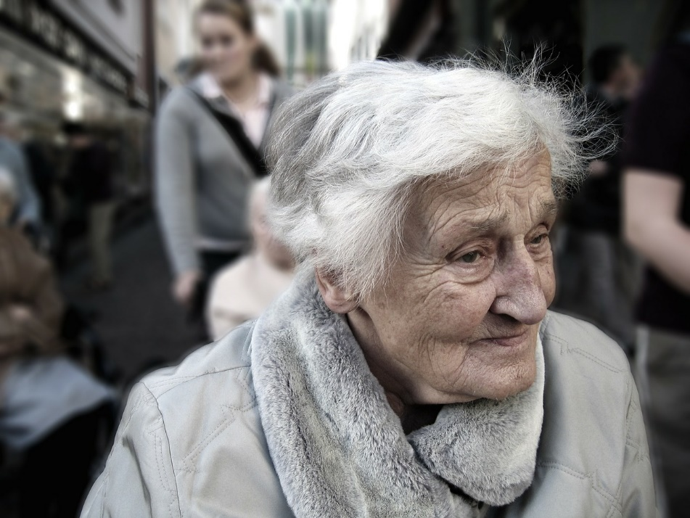
Negative Impact on Health
Functional decline
Increased risk for chronic disease
Cognitive decline
Poor health behaviors
Depression
Weakened immune system
Anxiety
Death

Slide 81
Financial Impact of Social Isolation
Increases annual Medicare costs by an estimated $6.7 billion
Medicare spends an estimated $1,608 per beneficiary annually
Socially isolated individuals were 29% more likely to get care in a skilled nursing facility
Medicare Spends More on Socially Isolated Older Adults. AARP Insight on the Issues #125. 2017.

Slide 82
Framework for Addressing Social Connectedness: Social-Ecological Model
Society
Community
Relationships
Individual
Age 75+
Living alone
Widowed or divorced
Limited financial resources
Psychological or cognitive vulnerabilities
Language barriers
No children
Mobility or sensory impairment
Major life transition
Ageism
Social norms
Discrimination
Marginalization
National, state, and local policies
Access to services, amenities, public transportation
Unsafe or inaccessible environment
Opportunities for social participation
Size and quality of social network
Frequency of contact with family, friends, and neighbors
Family conflict, disruption, and dysfunction

Slide 83
Promising Practices and Interventions for Social Connectedness
Characteristics of Successful Interventions
Adaptable
Community development approach
Productive engagement
Categories of Interventions
Social facilitation interventions: Facilitate social interaction with peers, provide mutual benefit to all participants involved
Psychological therapies: Therapeutic approaches delivered by trained therapists or health professionals
Health and social care provision: Involvement of health and social care professionals and enrollment in a formal program of care
Animal interventions: Canine or feline animal interventions, animal-assisted therapy
Befriending interventions: Formulate new friendships, typically 1:1 and involved volunteers
Leisure/skill development: Solitary or group-based, varied focus included gardening, computer/internet use, volunteer work, and sports
Gardiner et al., 2018

Slide 84
Promising Practices and Interventions for Social Connectedness
Group-based interventions
Actively engage older adults
Target specific groups (e.g., ethnic minorities)
Include educational and social aspect
Creative, therapeutic or discussion-based focus
Stress reduction
1:1 individual interventions
Improvement of social skills
Enhancing social support
Increasing opportunities for social interactions
Addressing maladaptive social cognition
Technology interventions
Allow frequent use of social technology
Visiting robotic dogs
Neighborhood interventions
Enhance neighborhood accessibility
Age-friendly communities
Perissinotto et al., 2019; Masi et al., 2011; Cotterell et al., 2018; Elder, 2012; Veazie, 2019

Slide 85
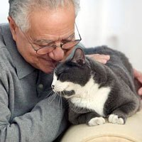
Looking Ahead
Public-private partnerships to identify and evaluate interventions for social isolation and loneliness
Utilize consistent screening and measurement across disciplines and healthcare settings
Develop evidence-based interventions
Increase public awareness and education about risk factors, assessment, and solutions

Slide 86
References
Holt-Lunstad, J., Smith, T. B., Baker, M., Harris, T., & Stephenson, D. (2015). Loneliness and social isolation as risk factors for mortality: A meta-analytic review. Perspectives on Psychological Science, 10, 227-237.
Perissinotto, C.M., Stijacic Cenzer, I., Covinsky, K.E. Loneliness in older persons: a predictor of functional decline and death. Arch Intern Med. 2012;172:1078-1083.
DiJulio, B., Hamel, L., Muñana, C. & Brodie, M. Loneliness and Social Isolation in the United States, the United Kingdom, and Japan: An International Survey. Kaiser Family Foundation Report. 2018.
Victor, C. (2011). Loneliness in old age: the UK perspective. Safeguarding the Convoy: a call to action from the Campaign to End Loneliness. Age UK Oxfordshire http://campaigntoendloneliness.org.uk/wp-content/uploads/downloads/2011/07/safeguarding-the-convoy_-_a-call-toaction-from-the-campaign-to-end-loneliness.pdf
K. Shimada, et al., “Prevalence of Social Isolation in Community-Dwelling Elderly by Differences in Household Composition and Related Factors: From a Social Network Perspective in Urban Japan,” J.AgingHealth, 2014 Aug;26(5):807-823. Epub20142014 May 8.
Wilson, D. M., Harris, A. , Hollis, V. and Mohankumar, D. (2011), Upstream thinking and health promotion planning for older adults at risk of social isolation. International Journal of Older People Nursing, 6: 282-288.
Loneliness and Social Connections: A National Survey of Adults 45 and Older (AARP). 2018.
Cornwell, E. Y., & Waite, L. J. (2009). Social Disconnectedness, Perceived Isolation, and Health among Older Adults. Journal of Health and Social Behavior, 50(1), 31–48.
Administration for Community Living 2017 Profile of Older Americans
Shankar A, Hamer M, McMunn A, & Steptoe A. Social isolation and loneliness: relationships with cognitive function during 4 years of follow-up in the English Longitudinal Study of Ageing. Psychosom Med. 2013 Feb;75(2):161-70. Epub 2013 Jan 29.
Poscia A, Stojanovic J, La Milia DI, et al. Interventions targeting loneliness and social isolation among the older people: An update systematic review. Exp Gerontol. 2018 Feb;102:133-44.

Slide 87
References Continued
Perissinotto, C. M., & Covinsky, K. E. (2014). Living alone, socially isolated or lonely—What are we measuring? Journal of General Internal Medicine, 11, 1429–1431.
Cacioppo, John T., and Louise C. Hawkley. "Perceived social isolation and cognition." Trends in cognitive sciences 13.10 (2009): 447-454.
Peplau, L. A., & Perlman, D. (Eds.). (1982). Loneliness: A sourcebook of current theory, research, and therapy. New York, NY: Wiley.
Ge, Lixia, et al. "Social isolation, loneliness and their relationships with depressive symptoms: A population-based study." PloS one 12.8 (2017): e0182145.
Masi, C. M., Chen, H. Y., Hawkley, L. C., & Cacioppo, J. T. (2010). A meta-analysis of interventions to reduce loneliness. Personality and social psychology review : an official journal of the Society for Personality and Social Psychology, Inc, 15(3), 219–266. doi:10.1177/1088868310377394
Perissinotto, C. , Holt‐Lunstad, J. , Periyakoil, V. S. and Covinsky, K. (2019), A Practical Approach to Assessing and Mitigating Loneliness and Isolation in Older Adults. J Am Geriatr Soc, 67: 657-662. doi:10.1111/jgs.15746
Cotterell N., Buffel, T., & Phillipson, C. (2018). Preventing social isolation in older people. Maturitas, 113 pp. 80–84.
Antonacopoulos, Nikolina M. Duvall, and Timothy A. Pychyl. “An Examination of the Possible Benefits for Well-Being Arising from the Social Interactions That Occur While Dog Walking.” Society & Animals 22, no. 5 (2014): 459–80. http://dx.doi.org.ezproxy.lib.purdue.edu/10.1163/15685306-12341338
Wood, Lisa, Billie Giles-Corti, and Max Bulsara. "The pet connection: Pets as a conduit for social capital?" Social science & medicine 61.6 (2005): 1159-1173https://doi.org/10.1016/j.socscimed.2005.01.017
Kramer, S. C., Friedmann, E., & Bernstein, P. L. (2009). Comparison of the effect of human interaction, animal-assisted therapy, and AIBO-assisted therapy on long-term care residents with dementia. Anthrozoös, 22(1), 43-57. https://doi.org/10.2752/175303708X390464
Veazie S, Gilbert J, Winchell K, et al. Rockville (MD): Agency for Healthcare Research and Quality (US); 2019.
Elder, K. & Retrum, J. Framework for Isolation in Adults Over 50; 2012. https://www.aarp.org/content/dam/aarp/aarp_foundation/2012_PDFs/AARP-Foundation-Isolation-Framework-Report.pdf

Slide 88
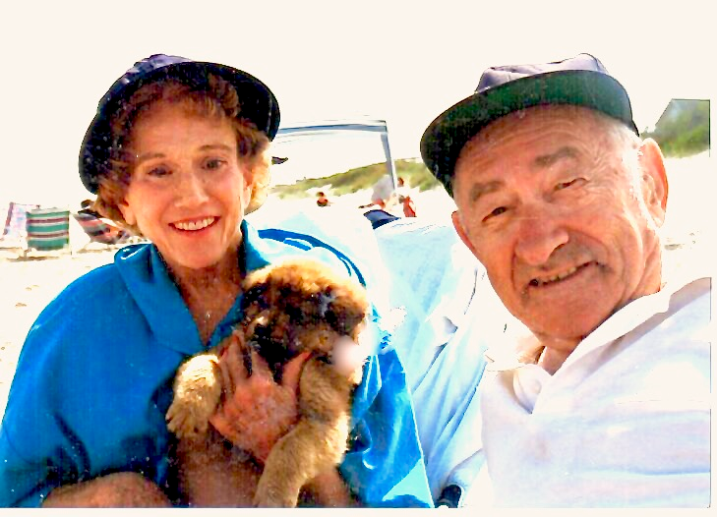
Thank You
Chelsea Gilchrist, MGS
Center for Healthy Aging
National Council on Aging
chelsea.gilchrist@ncoa.org

Slide 89
May 7, 2019 | Washington, DC

Slide 90
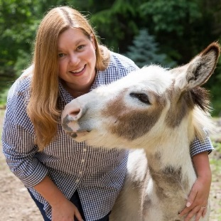
Mary Margaret Callahan Pet Partners

Slide 91
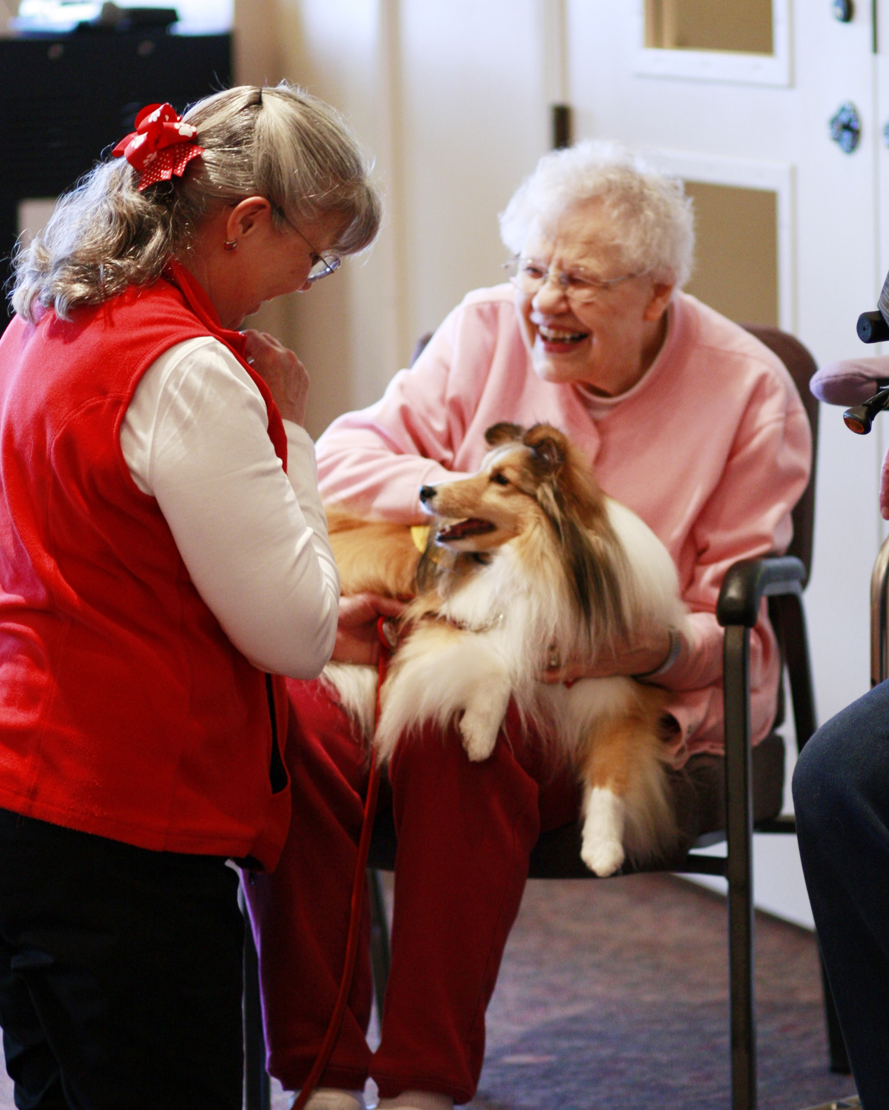
Mitigating Social Isolation through Therapy Animal Visits
Notes:
We all recognize animals provide companionship
Not everyone can/should/wants to have their own pet
Therapy animals can be an effective option for engaging older adults with animals to reduce social isolation

Slide 92
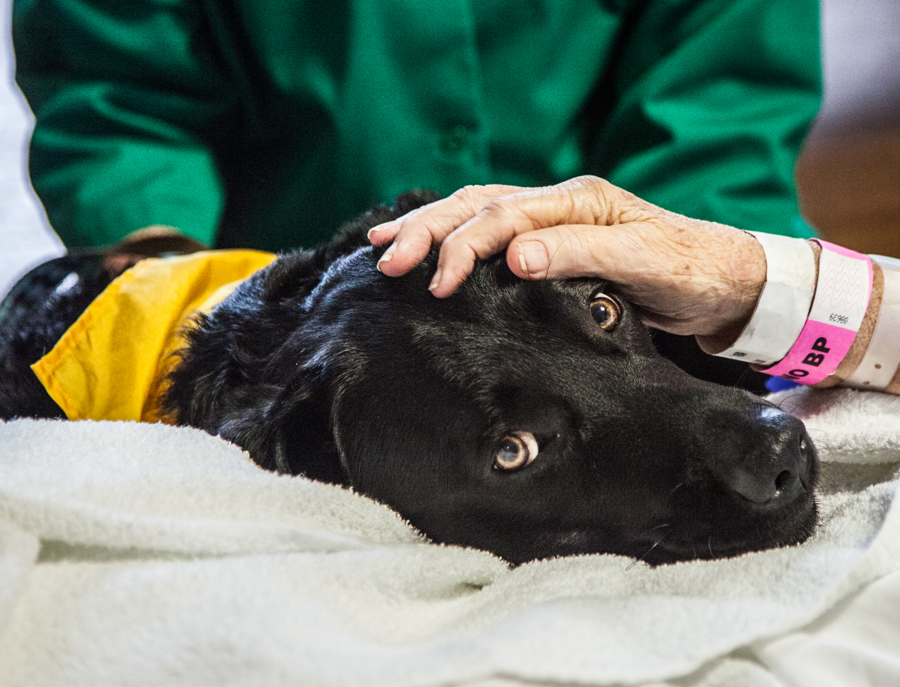
Whether active or passive interactions, there are a variety of reported benefits when seniors are visited by therapy animal teams.
Notes:
Benefits include improved enhanced mood, decreased depression, and facilitation of memory
Also noted, increased physical activity from stretching to pet, and co-walking
Social interaction between handler and client is just as important in addressing social isolation
Increase in socializing between nursing home resident and staff has been documented to continue after the visit has ended
Examples of Interactions:
Astute handlers will have different ways to have clients interact with their animal companions, although petting remains a time-honored way for people to engage with animals.
From reminiscing about animals that one had as a child, to speaking with the handler about their animal, aging adults can engage in social activities in many ways through therapy animal visits, and frequently for longer amounts of time than with other activities.
Even the observation of the therapy animal can be a positive experience.
No one is required to be visited. In fact, the ability to decline an interaction can be powerful.
That said, there are some steps that must be taken to ensure safe and effective interactions

Slide 93
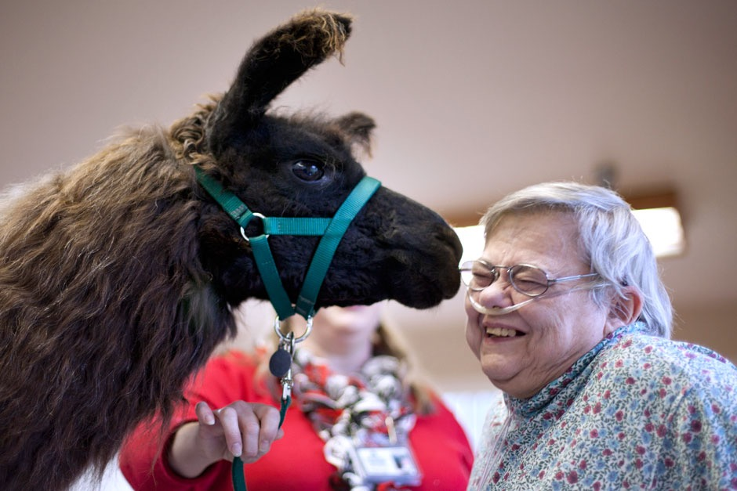
Pet Partners’ Promise: Safe and effective visits through handler training, assessment, animal welfare focus and safety standards.
Notes:
Pet Partners’ therapy animal program, which makes more than 3 million visits a year in all 50 states with 9 different species of animals, focuses on preparation in these four areas:
-handler training
-assessment
-animal welfare
-safety standards
We consider these aspects critical to a safe and effective visits

Slide 94
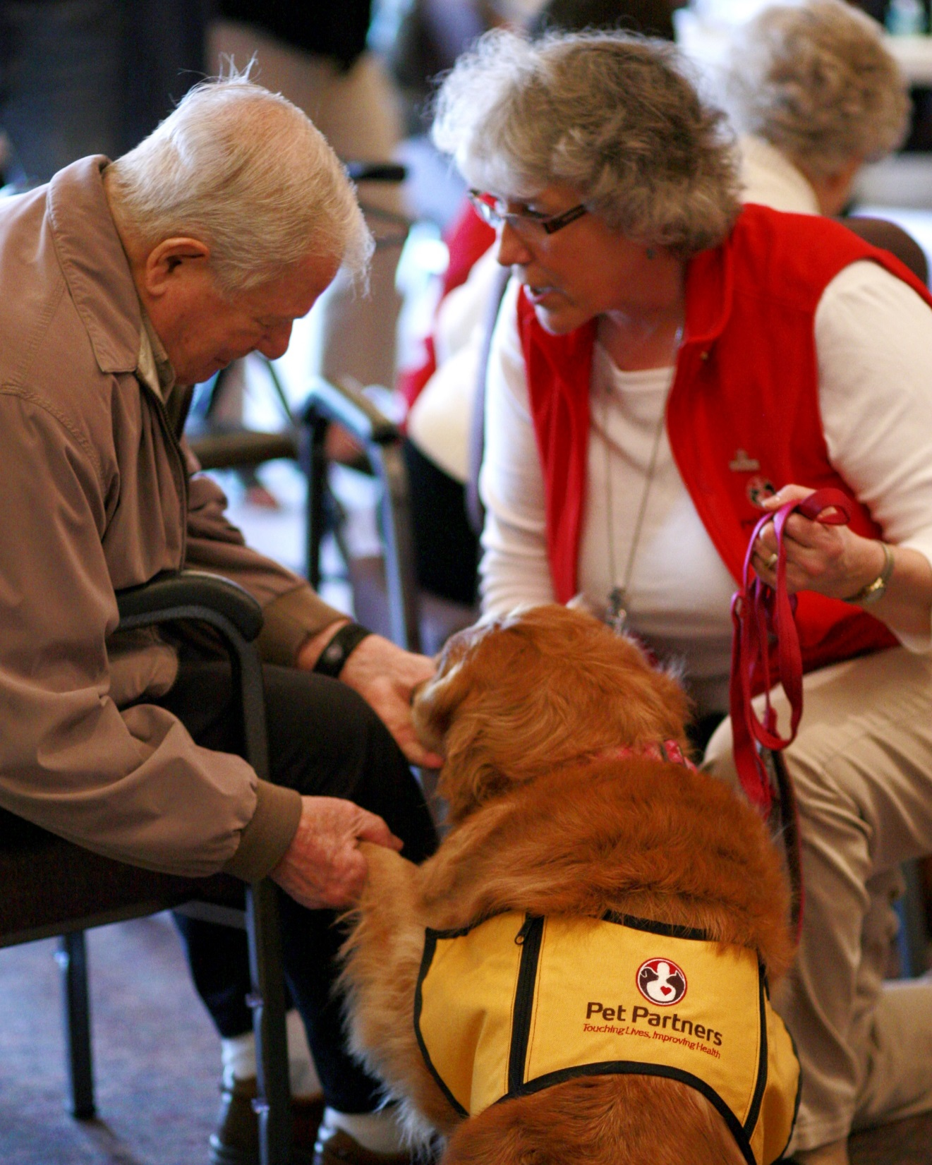
Handler Training
Handler Responsibilities
Handling Best Practices
Professional Conduct
Infection Prevention
Best Practices Working with Clients
Self-Care
Continuing Education
Notes:
While well-behaved animals that are reliable in a variety of situations are critical, handlers need a working knowledge of relevant best practices, from infection prevention and HIPAA regulations to working with the needs of specific populations.
Handlers with the ability to accurately interpret animal body language and proactively manage interactions keep everyone safe. Pet Partners offers a canine body language course consistent with SHEA guidelines
Pet Partners offers the only handler training on infection prevention publicly endorsed by the Society of Healthcare Epidemiology of America (SHEA).

Slide 95
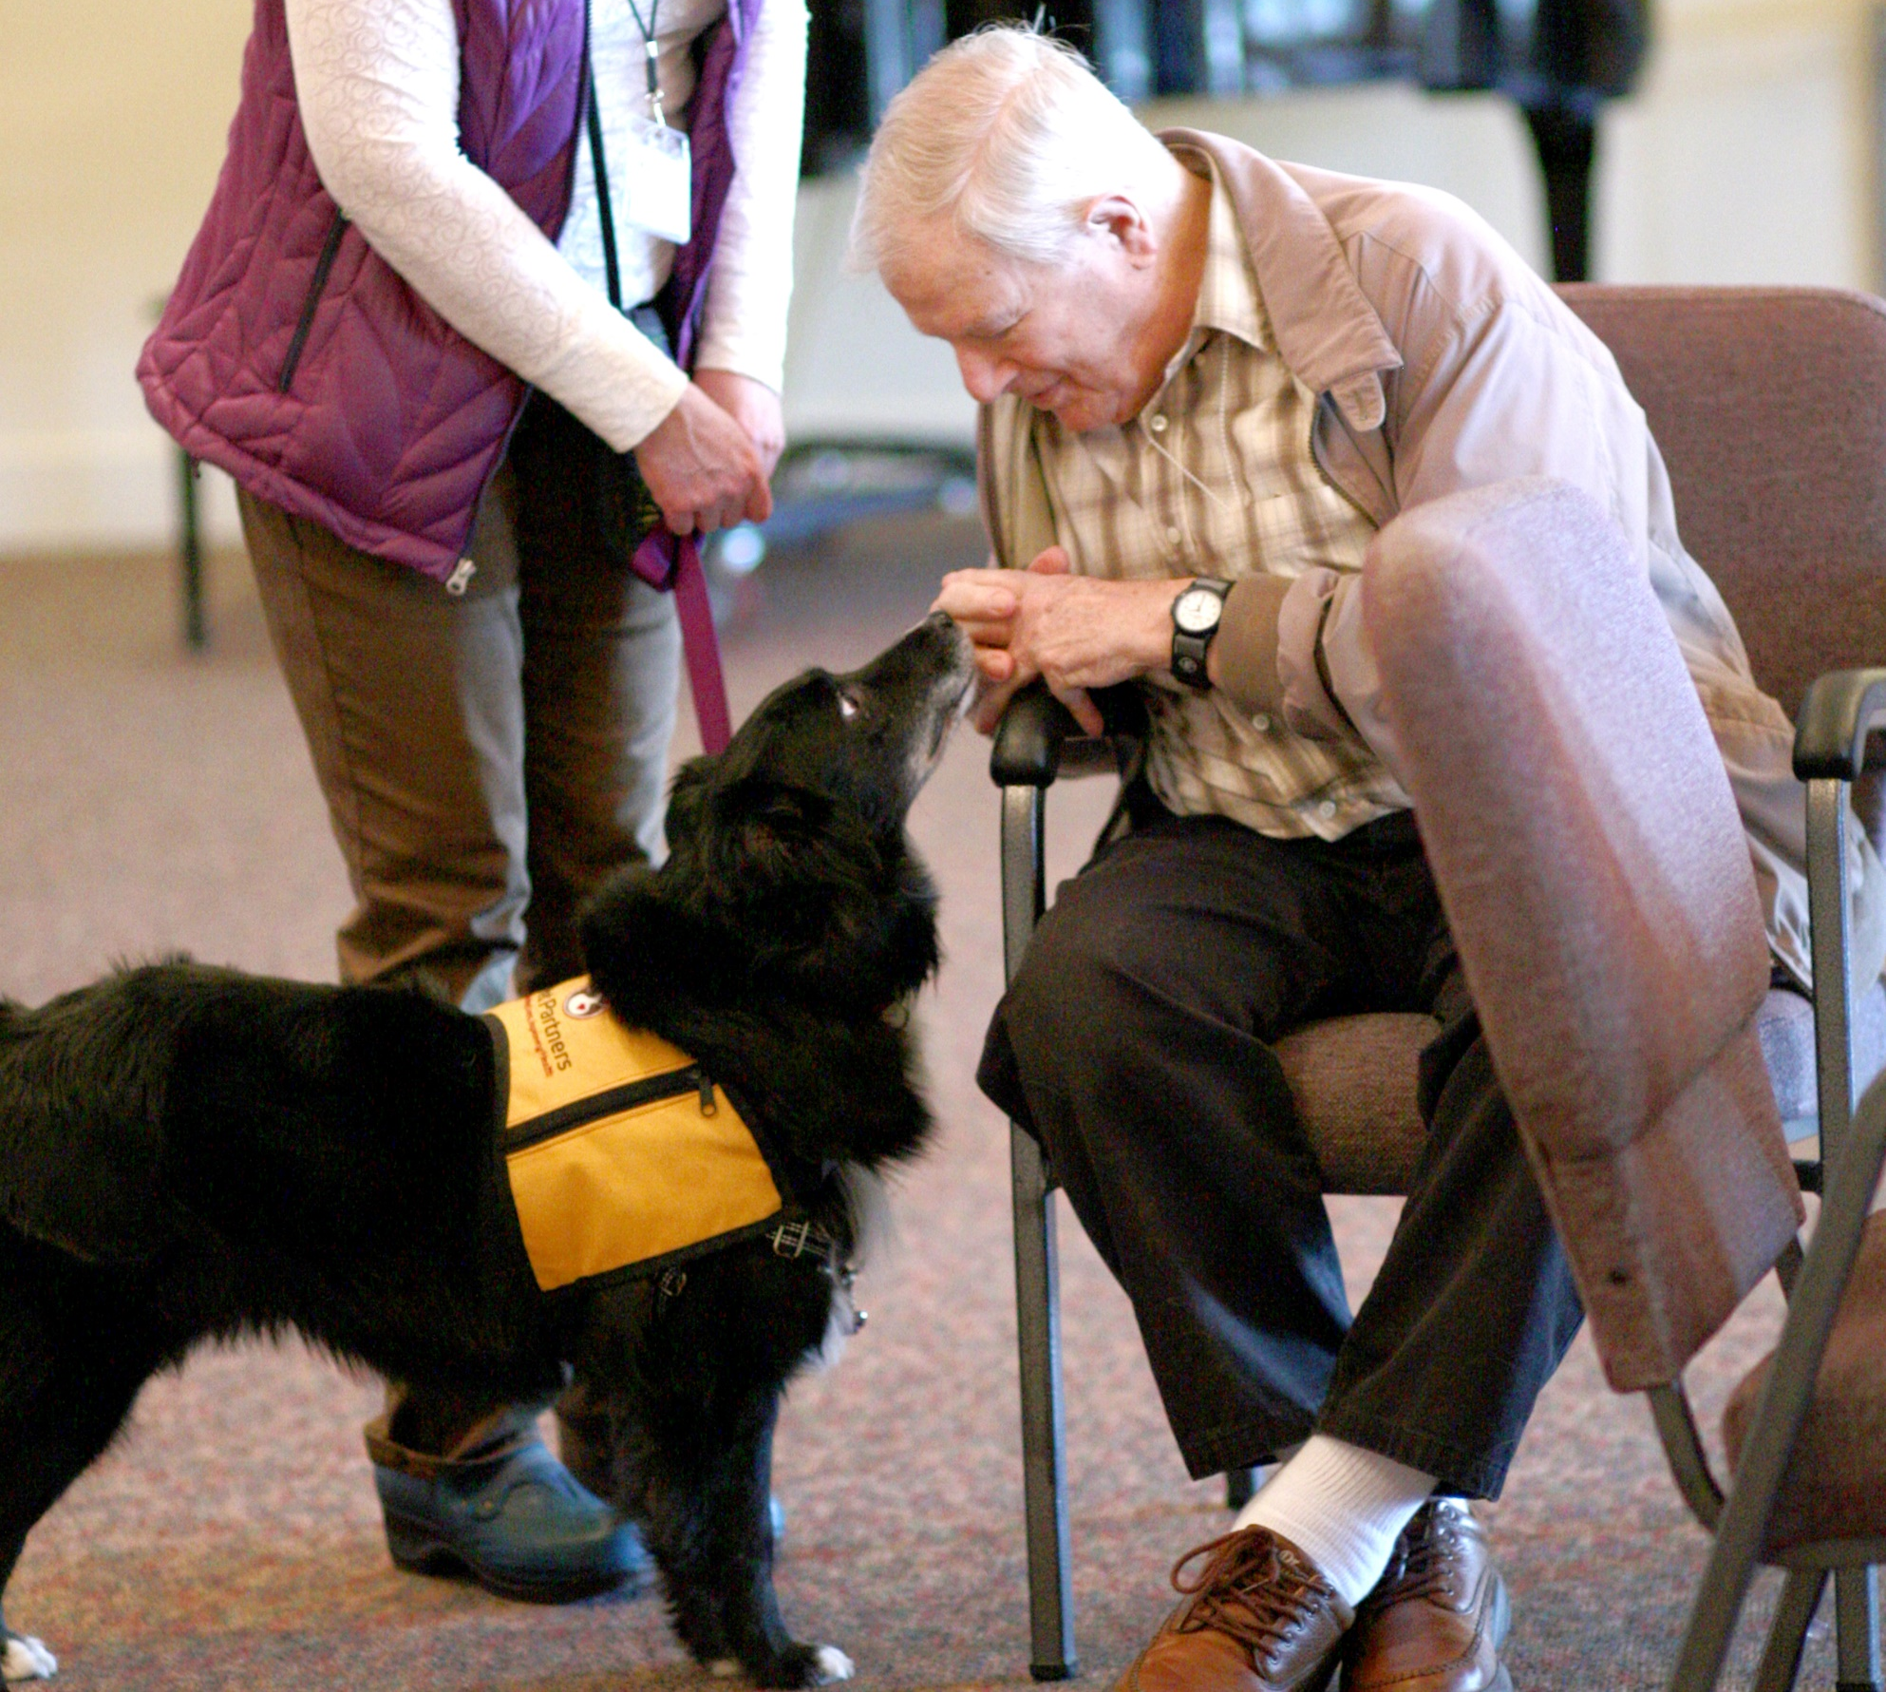
Handlers are assessed on
factual and applied knowledge
of best practices.
Teams complete a practical
assessment of skills and aptitude that demonstrates their ability to
interact safely and effectively.
Notes:
Assessment should be thorough, recurring and include practical skills as well as knowledge base. For us this includes a written test and an in-person, role play based evaluation which recurs every 2 years.
It can be too easy to fixate on an animal’s training. While animals do need obedience skills and the right temperament or aptitude, it is the handler who is ultimately respsonsible for guiding interactions and setting everyone up for success.

Slide 96
Recognizing that we ask animals to
participate, their
welfare is prioritized; they should enjoy,
not simply tolerate,
therapy work.
Notes:
Safety of clients and by extension risk management is directly tied to animal welfare.
The core tenet of Pet Partners Therapy Animal Program is “you are your animal’s best advocate,” also known as YAYABA™. This requires handlers to modify or end interactions animals no longer enjoy, consistent with animal welfare guidelines.
Pet Partners limits all visits to no longer than two hours, consistent with recommendations to limit overwork and fatigue
Pet Partners ascribes to a relationship based handler-animal support model during visits, a skill on which handlers are assessed during the evaluation process, known to Pet Partners handlers as PETS™.

Slide 97
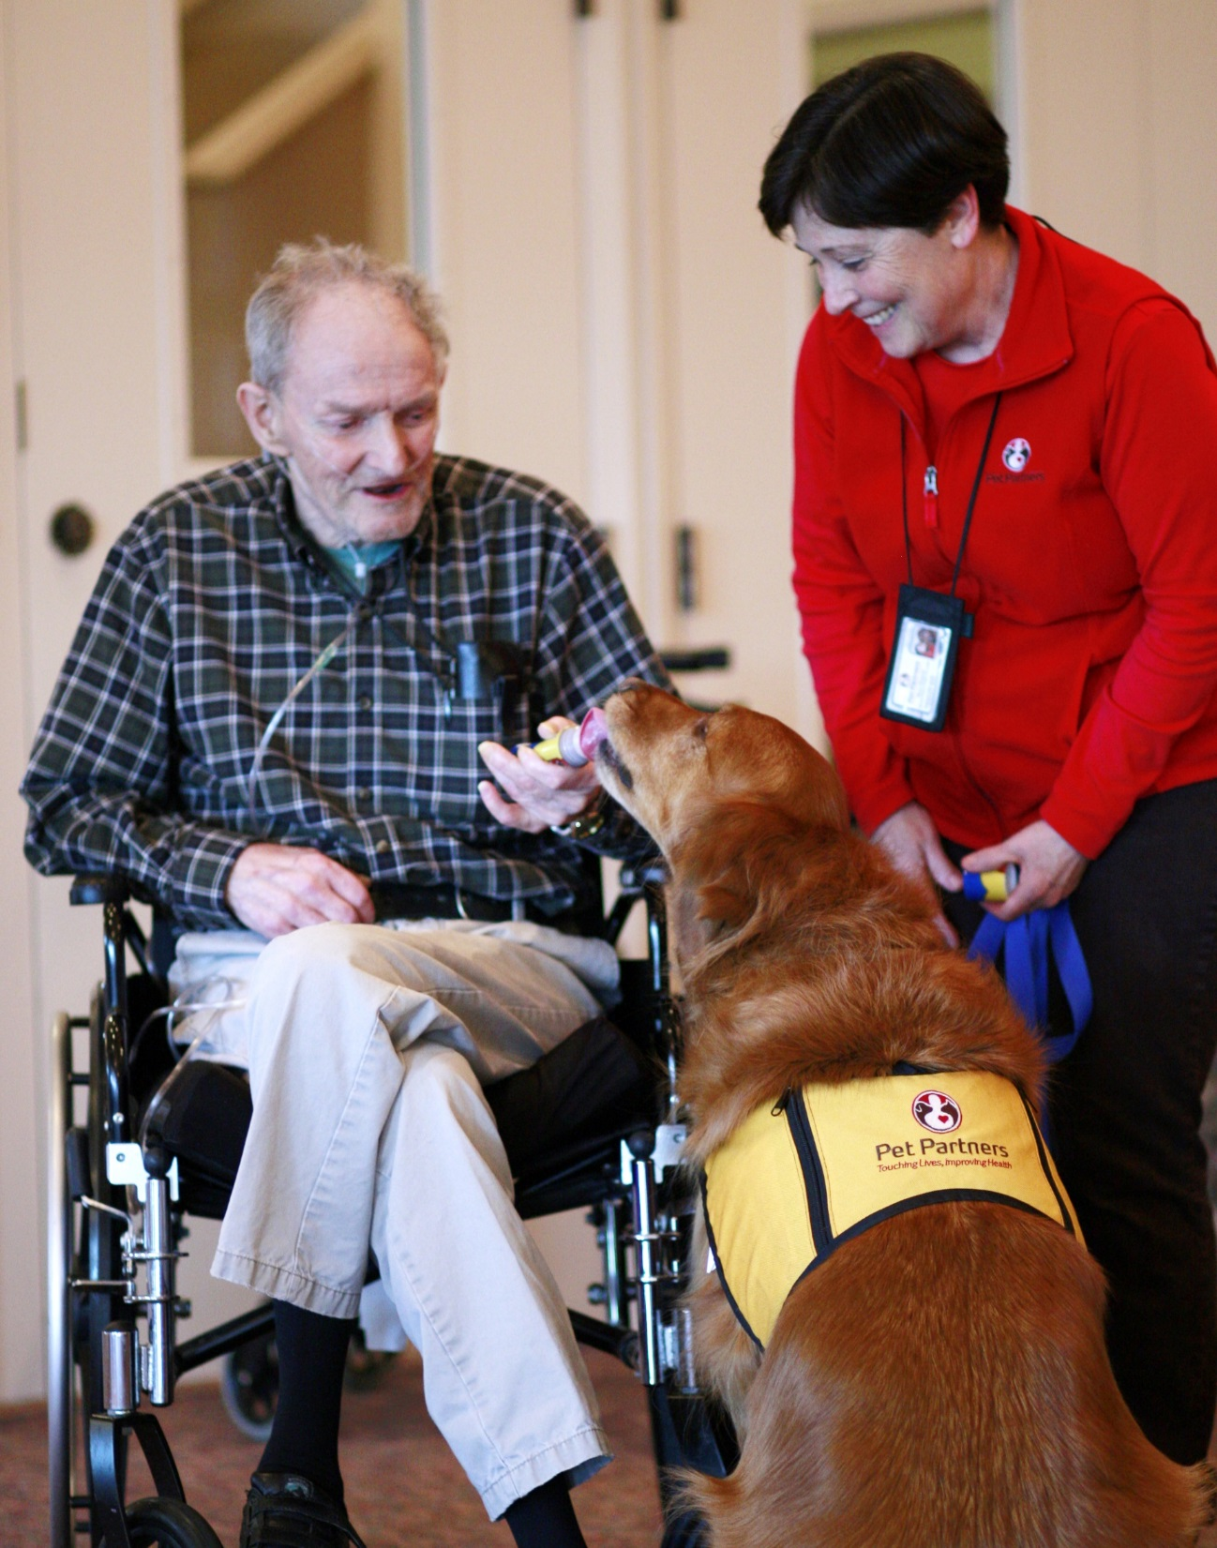
Safety Standards
Handler & animal health requirements
Rabies vaccinations
No raw meat diets
Hand hygiene, grooming. barrier use
Insurance coverage
Incident management
Notes:
There are real considerations that need to be made regarding infection prevention.
Handler and animals must be healthy to participate.
Additionally, we have conservative practices regarding rabies vaccinations, raw protein diets and hygiene that reduces the chance of zoonotic transmission.
If incidents, or perceived incidents, do occur, our internal process for addressing policy violations or poor judgement
Fortunately because of the training and precautions in this area we very rarely need to call on our insurance coverage.

Slide 98
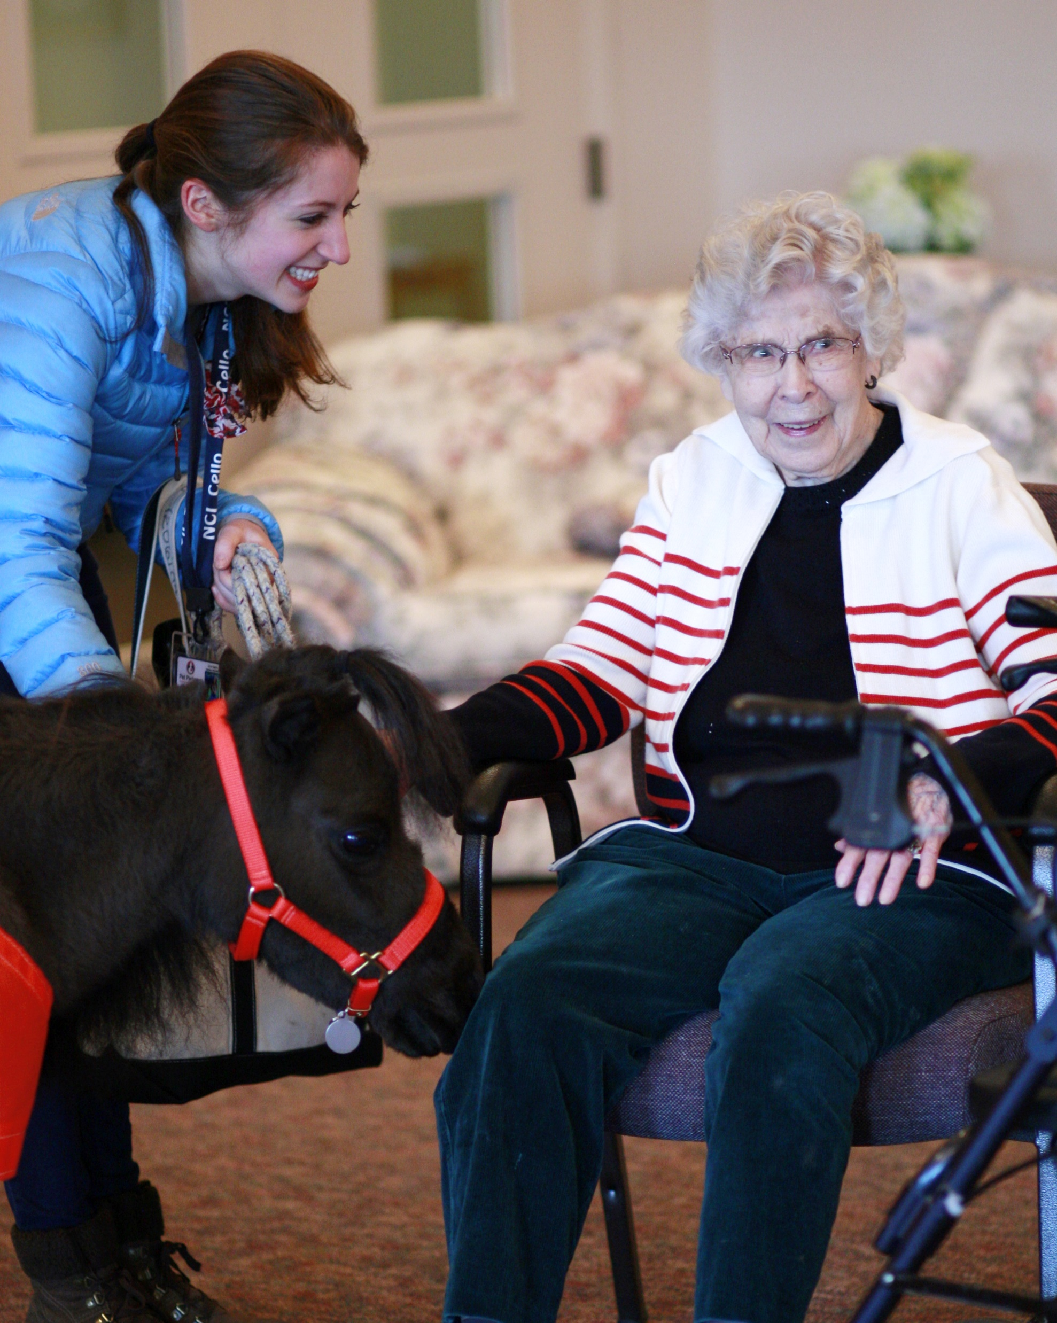
Finding the Right Fit
Notes:
Best teams for aging adults
-animals of any size who are calm and controlled in their movements
-handlers who enjoys making conversation with older adults will amplify the positive impact of visits
-handlers with access to CE, such as training on Alzheimer's and other forms of dementia, will best prepare handlers to deliver safe and effective visits
While we hope facilities seeking therapy animal teams will choose Pet Partners, if that’s not possible, we strongly urge every facility to consider selecting teams who meet minimum standards for safety and animal welfare. This extends to facilities considering facility animals, where there is no less – and in fact sometimes even greater - challenges regarding animal welfare

Slide 99
Thank you
WWW.PETPARTNERS.ORG
Mary Margaret Callahan
Chief Mission Officer
marymargaretc@petpartners.org

Slide 100
May 7, 2019 | Washington, DC

Slide 101
Panel on Older Adults
Nancy Gee, PhD - Moderator
Professor, Department of Psychology
State University of New York at Fredonia
HAI Research Manager, Mars – WALTHAM™ Centre for Pet Nutrition
Dawn Carr, PhD
Assistant Professor, Department of Sociology
College of Social Sciences and Public Policy
Florida State University
Chelsea Gilchrist, MGS
Senior Program Manager, Center for Healthy Aging
National Council on Aging (NCOA)
Erika Friedmann, PhD
Associate Dean of Research ‌Professor, OSAH
University of Maryland
Mary Margaret Callahan
Chief Mission Officer
Pet Partners
Molly McAllister, DVM, MPH
Vice President Veterinary Science Banfield Pet Hospital | Veterinary Affairs

Slide 102
May 7, 2019 | Washington, DC

Slide 103
The biopsychosocial model for the effects of human-animal interaction on healthy aging
Psychological (Emotional) Realm
↑Positive Affect
↓Stress
↓Depression
↓Anxiety
Biological Realm
Age
Sex
Race
Health
↑Well-Being
↓Symptoms
↓CVD/Mortality
↑Cognitive Function
↑Physical Function
Social Realm
↓Loneliness
↓Social Isolation
↑Companionship
↑ Social Relationships
↑ Social Activities
Pet Ownership/HAI

Slide 104
May 7, 2019 | Washington, DC

Slide 105
Q&A

Slide 106
Lunch

Slide 108
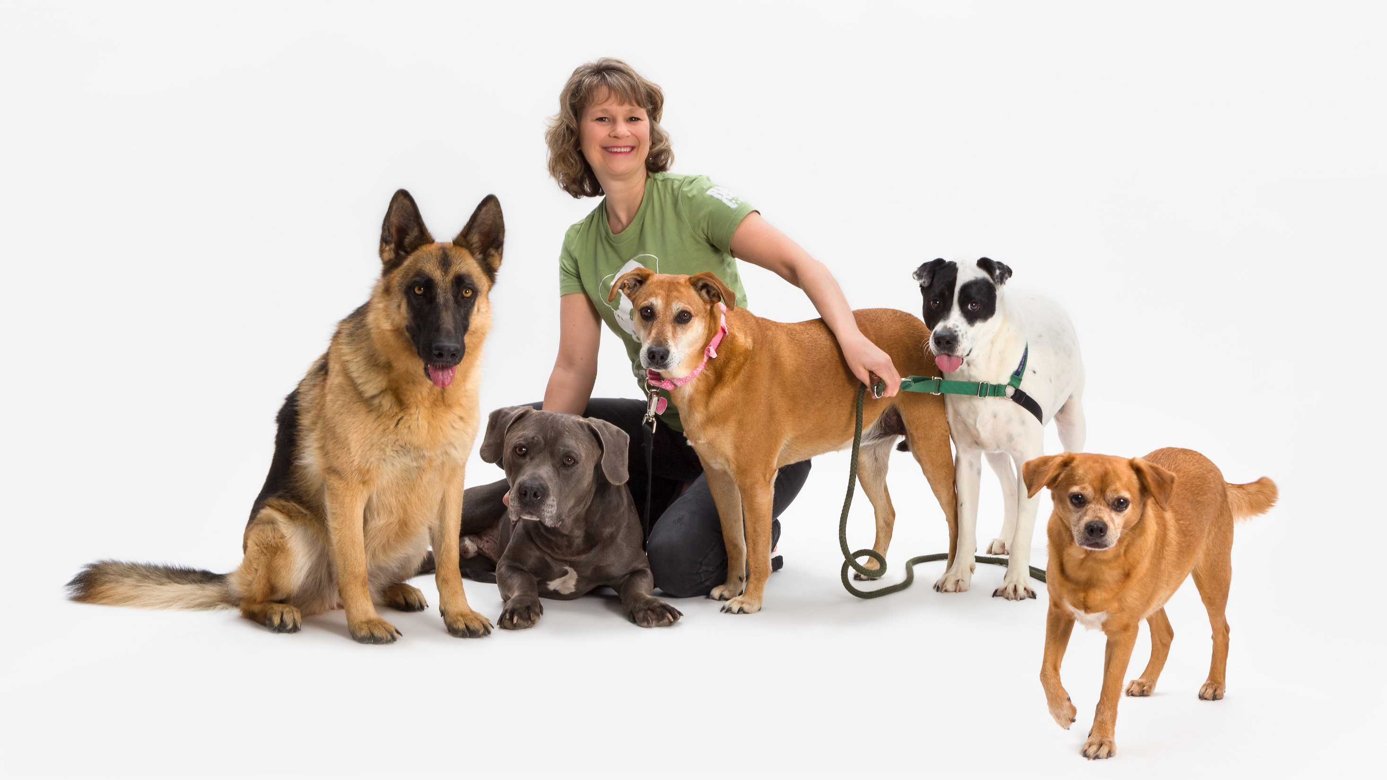

Slide 109
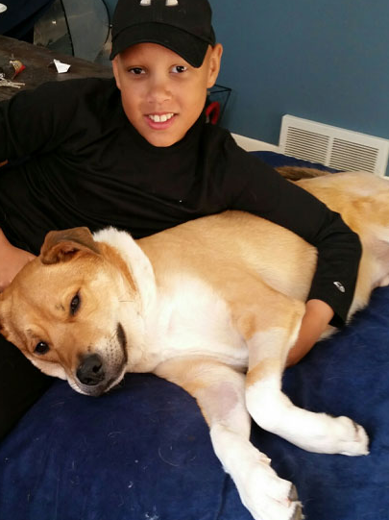
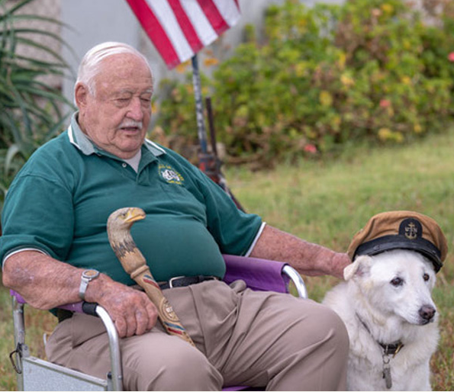
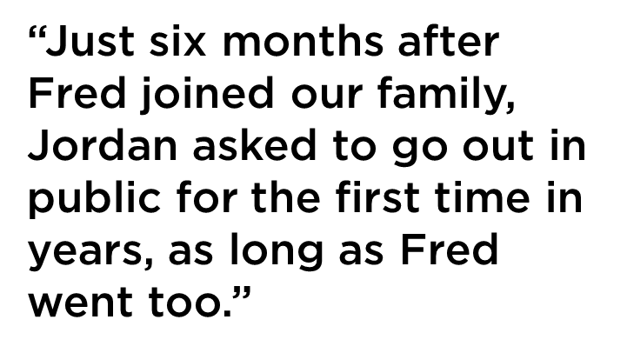
Notes:
adopted dog helps middle school student find his confidence
adopted dog gives veteran a new lease on life

Slide 110
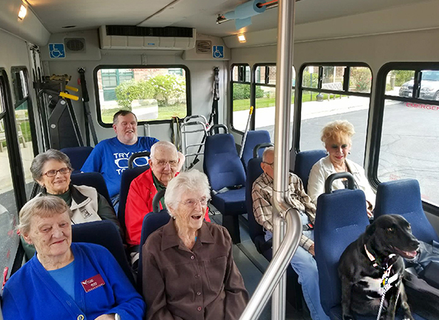
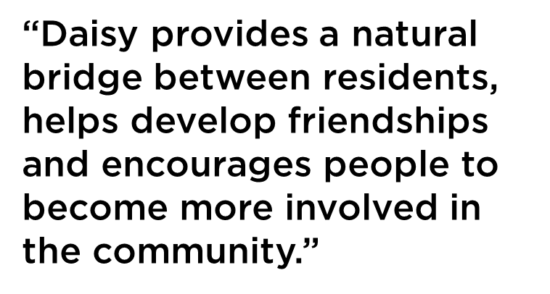
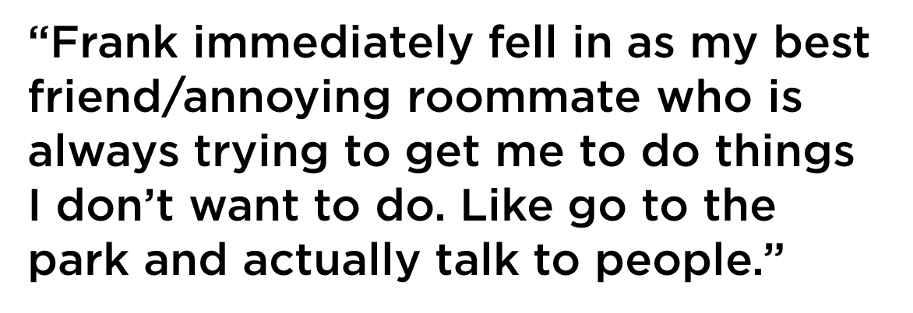
Notes:
young dog brings new life to senior community
early bird dog helps chronic sleeper see the light

Slide 111
May 7, 2019 | Washington, DC

Slide 112
Pets and Mental Health
1 in 4 (26%) pet owners stated they got a pet to improve their mental health – with respondents aged 55+ doing so more frequently (55%)
Survey of 1,469 U.S. pet owners and 567 non-owners conducted by Edelman Intelligence, December 2018, MoE + 5%

Slide 113
Section 3: People with Mental Health Challenges, Social Isolation, Loneliness & Companion Animals

Slide 114
Why are Social Isolation & Loneliness Particularly Problematic for People with Mental Health Challenges?

Slide 115
Aubrey Fine, EdD California State Polytechnic University

Slide 116
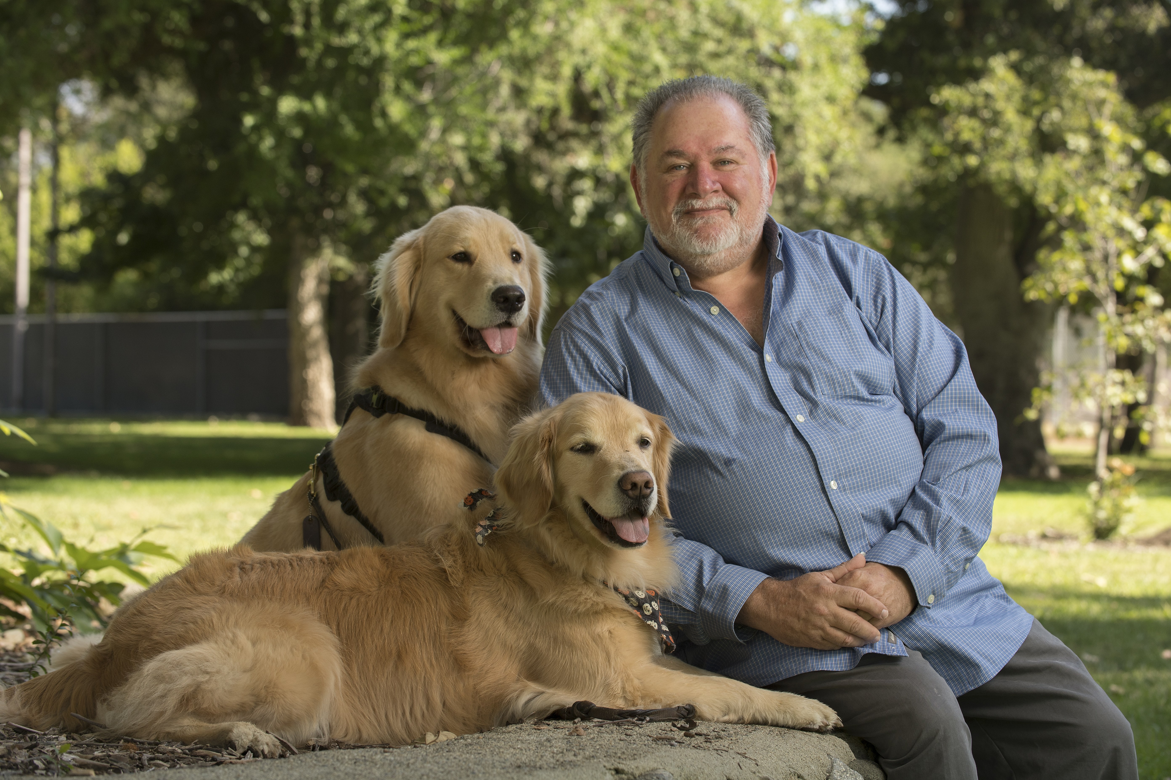
The Impact of Social Isolation and Children with DisabiLities: The Role of Animal CompanioNship

Slide 117
social isolation and loneliness: Working Definitions
Social isolation is a paucity or minimal social contact with others; such as family or community differs from
loneliness,
which reflects a state of distress due to self perceptions of being lonely or not belonging ₁

Slide 118
Understanding the real Human Casualty of Isolation and loneliness

Slide 119
Consequences of Childhood and Adolescent Isolation and Loneliness
More likely to experience poor school adjustment ₄
Problematic behavior
Mental health problems
Depression 2
Anxiety ₅
Increase in externalized Behavior problems ₍disobeying rules, and physical aggression)
Increase in unhealthy Internalized Behaviors (fearfulness, social withdrawal)
Negative self –worth
Physical health problems late in life
Mortality _{7 and 3}
Altered cardiovascular activity
Hypertension
Acceleration of Atherosclerosis

Slide 120
Depression and Loneliness: How do they Correlate
Depression
Loneliness
Loneliness can be understood as either a symptom of, or a predisposing factor to depression.
Depression-related mechanisms may lead to interpersonal problems and increase risk of loneliness.
This relationship may cause those who feel lonely to suicidal ideations. ₈

Slide 121
The effect of loneliness and the development of depression
Qualter et al (2010)
An 8 year study conducted by the Australian Government on 296 children
Study examined the effects of childhood loneliness on depressive symptoms
Children were assessed at ages 5, 9 and 13
1) Study found that the stability of childhood loneliness predicted later adolescent reports of depressive symptoms
2) Enduring 4 years of loneliness is linked to symptoms of depression
3) Enduring loneliness represents an internal stressor that plays a role in a later symptoms of depression ₉

Slide 122
NIH and the Pathway Project
The 2013 study (239 males and females)
Children and their families were recruited prior to entry into kindergarten and followed through school years
Data collected during grades 6 through 12.
Findings showed that initial levels of loneliness and depressive symptoms were moderately and positively correlated
Depressive symptomatology across the adolescent age period rises and falls in conjunction with youth's loneliness experiences
Study found chronic loneliness to be associated with an increase in depression ₁₇

Slide 123
Social Isolation in Adulthood and Depression The Findings are similar!
A University of Michigan study examined social relationships and depression (sample of 4,642 adults)
Study suggests that social relationships may be an important area to target among adults at risk for clinical depression.
Quality is more important than quantity appears true in the effect of social relationships on depression.
The magnitude of effect of social relationship quality on risk for depression is comparable with the effect of well- established biological risk factors for cardiovascular disease. ₁₆

Slide 124
Bill and his cats: A face of Loneliness
“They pick up on my feelings of loneliness and comfort me in a way I could not imagine. When they know I am sad, they are more attentive to me; almost to the point of annoyance because they won’t leave me alone. I somehow find a spiritual connection with them; the process of petting them and taking care of them allows me to take a break from my own mental anguish. Many times I sing with them and find this as an outlet to relieve some of my anxiety “.

Slide 126
How might Pet Companionship be supportive?
Act as Social CapitOl
Greater connections to the community as a whole
Support more engagement
Improved physical activity outside the home– e.g. dog walking
Emotional Regulation
Motivational Hypothesis: May facilitate the motivation to Become more involved with others because the Pet may act as a social support
PROMOTE RELAXATION: and ease
Notes:
Capture and hold the attention of children
May facilitate (prime) external learning
Emotional arousal or improved emotion
ADHD: deficit of motivation & under arousal
Diff for ADHD kids to engage attention in social settings
Not enough anxiety to self-regulate
Low motivation to participate in benign tasks
Motivation hypothesis: May facilitate motivation to learn

Slide 128
High Functioning ASD and Social Isolation
Deficits in Social relations are often a feature of ASD₈
deficits can lead to:
Anxiety
Loneliness (Hedley et al. 2018)
Increased depression
Low self esteem
Suicidal ideation
Misinterpreted friendships
Social isolation has been found to be a contributing factor for suicide
In a Swedish mortality study suicide was found to be the leading cause of premature death in those who have ASD (Hirvikoski et al. 2016)

Slide 129
Social Isolation and ADHD
Children with ADHD are at increased risk of suffering of isolation.
Due to experiencing peer difficulties
Rejection
Rejection is a risk strong risk factor for depression ₁₅
Irritating or annoying peers
Are likely to have trouble building effective communication skills and poor interpersonal skills
Children and adolescents with ADHD also perceive themselves as having fewer positive features and more negative features in regards to their friendships ₁₄

Slide 130
Thanks for Inviting Me

Slide 132
EVERYONE needs that champion

Slide 133
“That Champion Can be an animal!”

Slide 134
A Special Thanks is given to Claudia Esquivel Arellano for her support in researching and helping develop this Powerpoint.

Slide 135
References
Alpert, Patricia T. “Self-Perception of Social Isolation and Loneliness in Older Adults.” Home Health Care Management & Practice 29, no. 4 (November 2017): 249–52. doi:10.1177/1084822317728265.
Laursen, Brett, William M. Bukowski, Kaisa Aunola, and Jari-Erik Nurmi. "Friendship Moderates Prospective Associations between Social Isolation and Adjustment Problems in Young Children." Child Development 78, no. 4 (2007): 1395-404. http://www.jstor.org.proxy.library.cpp.edu/stable/4620709
Cacioppo, and Hawkley. "Perceived Social Isolation and Cognition." Trends in Cognitive Sciences 13, no. 10 (2009): 447-54.
Asher, Steven R., and Julie A. Paquette. "Loneliness and Peer Relations in Childhood." Current Directions in Psychological Science 12, no. 3 (2003): 75-78. http://www.jstor.org.proxy.library.cpp.edu/stable/20182843.
Crick, Nicki R., and Gary W. Ladd. 1993. “Children’s Perceptions of Their Peer Experiences: Attributions, Loneliness, Social Anxiety, and Social Avoidance.” Developmental Psychology 29 (2): 244–54. doi:10.1037/0012-1649.29.2.244.
.Woodhouse, Susan S., Matthew J. Dykas, and Jude Cassidy. "Loneliness and Peer Relations in Adolescence.”. Social Development21, no. 2 (2012): 273-93.
Xia, Ning, and Huige Li. "Loneliness, Social Isolation, and Cardiovascular Health." Antioxidants & Redox Signaling 28, no. 9 (2018): 837-51.
Hedley, Uljarević, Wilmot, Richdale, and Dissanayake. "Understanding Depression and Thoughts of Self-harm in Autism: A Potential Mechanism Involving Loneliness." Research in Autism Spectrum Disorders 46 (2018): 1-7.
Qualter, Pamela, Stephen Brown, L. Munn, and Penny Rotenberg. "Childhood Loneliness as a Predictor of Adolescent Depressive Symptoms: An 8-year Longitudinal Study." European Child & Adolescent Psychiatry 19, no. 6 (2010): 493-501.
Devine, D.P. Psychopharmacology (2014) 231: 979. https://doi-org.proxy.library.cpp.edu/10.1007/s00213-013-3279-2
Bauminger, Nirit, and Connie Kasari. "Loneliness and Friendship in High‐Functioning Children with Autism." Child Development 71, no. 2 (2000): 447-56.

Slide 136
12. Hedley, Uljarević, Wilmot, Richdale, and Dissanayake. "Understanding Depression and Thoughts of Self-harm in Autism: A Potential Mechanism Involving Loneliness." Research in Autism Spectrum Disorders 46 (2018): 1-7.
13. Dr. Fine powerpoint slides
14. Matthews, Danese, Wertz, Ambler, Kelly, Diver, Caspi, Moffitt, and Arseneault. "Social Isolation and Mental Health at Primary and Secondary School Entry: A Longitudinal Cohort Study." Journal of the American Academy of Child & Adolescent Psychiatry 54, no. 3 (2015): 225-32.
15.Kumar, Poornima, Gordon D Waiter, Magda Dubois, Maarten Milders, Ian Reid, and J Douglas Steele. "Increased Neural Response to Social Rejection in Major Depression." Depression and Anxiety 34, no. 11 (2017): 1049-056.
16. Alan R Teo, Hwajung Choi, and Marcia Valenstein. "Social Relationships and Depression: Ten-year Follow-up from a Nationally Representative Study." PLoS ONE 8, no. 4 (2013): E62396.
17. Ladd, and Ettekal. "Peer-related Loneliness across Early to Late Adolescence: Normative Trends, Intra-individual Trajectories, and Links with Depressive Symptoms." Journal of Adolescence 36, no. 6 (2013): 1269-282.

Slide 137
May 7, 2019 | Washington, DC

Slide 138
Dogs on Call: A best practices hospital-based AAI program

Slide 139
Sandra Barker, PhD, NCC, LPC Virginia Commonwealth University

Slide 140
Dogs On Call: A best practices hospital-based AAI program
Sandra B. Barker, Ph.D.
Professor of Psychiatry and Bill Balaban Chair
in Human-Animal Interaction
Director, School of Medicine Center for Human-Animal Interaction

Slide 141
Dogs On Call
®
A clinical program of The Center for Human-Animal Interaction in The School of Medicine at Virginia Commonwealth University (VCU)
Established in 2001
Non-profit 501 (c) (3) through Medical College of Virginia Foundation
Mission: Improved health and well-being through human-animal interaction
Pursue our mission through goal-oriented clinical, educational, and research activities

Slide 142
What is Best Practice?
A program that has been shown to consistently show superior results based on research and experience
Considers sustainability and ongoing development
Established or proposed as a model for widespread adoption

Slide 143
Best Practice: An integrated clinical, research, and education program model
What we learn from our Dogs
On Call teams
Informs our research
Enriches education
Establishes efficacy

Slide 144
Best Practice: Policies and procedures to maximize human and canine safety
Developed/adopted by VCU Medical Center in 2001
Involved physician and nursing leadership, epidemiology, risk management, volunteer services, security, animal care and use advisory program, Center director
Consulted existing CDC, veterinary and animal-assisted activity/therapy guidelines
Started with Pet Partners policies and strengthened with specific policies and procedures for visiting in our hospital and clinics
Routinely reviewed and revised to maximize safety for patients, staff, dogs, and volunteers

Slide 145
Dogs On Call: Best Practice
Manualized program with continuous monitoring, evaluation, and continuing education for team members
Fully integrated into VCU Medical Center
More than 75 active Dogs On Call teams
Areas visited based on consultation with infection control, medical directors, and nurse coordinators
All areas except operating and isolation rooms and food preparation areas
Online scheduling and on-site check-in and check-out procedures to monitor visits
High safety profile and high demand for visits

Slide 146
Dogs On Call Requirements
Species limited to adult dogs
Current registration with Pet Partner’s Program or Alliance of Therapy Dogs
Completion of VCU Medical Center Volunteer training
Completion of Dogs On Call Orientation
Compliance with Medical Center/Dogs On Call policies and procedures
Includes annual veterinary wellness documentation
Includes criterion-based Dogs On Call renewal evaluation every other year

Slide 147
Dogs On Call: Best Practice
Demonstrated benefits for healthcare teams
Physiological stress levels significantly reduced after brief interactions with DOC teams
DOC requested following stressful/critical events
Included in VCUMC initiatives (Dept of Surgery Wellness Initiative, Physician Stress Management Resources, Medication Safety Committee, Staff/student well-being)
Demonstrated benefits for our students
Significant reduction in perceived stress following a single DOC activity
Requested presence at key events
Demonstrated benefits for our patients

Slide 148
407 patients surveyed after a Dogs On Call Visit

Slide 150
Dogs On Call Efficacy

Slide 151
Dogs On Call efficacy with patients with mental health challenges
Anxiety levels of hospitalized psychiatric patients are reduced following a single Dogs On Call visit
One 15-minute Dogs On Call visit prior to Electroconvulsive Therapy (ECT) reduced patients’ fear by 37% and anxiety by 18%
Dogs On Call presence in group psychotherapy significantly increased attendance by patients with mood and psychotic disorders
Nursing staff perceived improved patient mood

Slide 152
Other evidence of AAI for those with mental health disorders
Reduced symptoms of anxiety, depression, pain, fear, and traumatic stress
Increased social interactions and activity levels
Enhanced well-being and quality of life
Increased positive affect
Improved self efficacy and self esteem
Increased tolerance for negative emotions during psychotherapy
Not all studies find benefits of AAI

Slide 153
For more information about Dogs On Call and CHAI
www.chai.vcu.edu
facebook.com/humananimalinteraction
twitter.com/dogsoncall
#dogsoncall
sandra.barker@vcuhealth.org
®

Slide 154
May 7, 2019 | Washington, DC

Slide 155
James Griffin, Ph.D. Eunice Kennedy Shriver National Institute of Child Health & Development, National Institutes of Health

Slide 156
Panel on People with Mental Health Challenges
Dominique Apollon, M.Ed.
Staff Therapist, Manager of Collaborative Care & Outreach
Light on Anxiety CBT Treatment Center
James A. Griffin, PhD
Deputy Chief, Child Development & Behavior Branch
Early Learning and School Readiness Research Program Eunice Kennedy Shriver National Institute of Child Health and Human Development
National Institutes of Health
Zenithson (Zenny) Ng, DVM, MS, DABVP
Clinical Assistant Professor
Department of Small Animal Clinical Sciences
The University of Tennessee Institute of Agriculture
College of Veterinary Medicine
Dominique Apollon, M.Ed., LPC, CCATP
Clinical Mental Health Therapist
Light on Anxiety CBT Treatment Center
Sandra Barker, PhD, NCC, LPC
Professor
School of Medicine
Center for Human-Animal Interaction
Virginia Commonwealth University
Megan Kiely Mueller, PhD
Elizabeth Arnold Stevens Junior Professor
Assistant Professor, Cummings School of Veterinary Medicine at Tufts University
Aubrey H. Fine, EdD
Professor Emeritus, Department of Education
California State Polytechnic University
Practicing Psychologist

Slide 157
May 7, 2019 | Washington, DC

Slide 158
Q&A

Slide 159
Afternoon Break

Slide 160
People Support Pet-Friendly Policies
People believe governments – both state (41%) and federal (38%) – have a degree of responsibility to foster companion animal interaction
Half of people aged 18-34 say they believe governmental organizations should take a leading role in fostering companion animal interaction
Survey of 1,469 U.S. pet owners and 567 non-owners conducted by Edelman Intelligence, December 2018, MoE + 5%

Slide 161
Summary & Next Steps

Slide 162
Supporting High-Quality Research
Solid methodological approaches
More sophisticated approach to pet ownership
Bring together diverse research teams, populations, locations
Support larger, more robust studies
‘Manualization’ of protocols

Slide 163
Sharing Best Practices
Proliferate high standards
Incorporate animal care and welfare / involve veterinarians
Scale-up programs that work
Monitoring/maximize efficacy

Slide 164
Addressing Barriers & Solutions
Research funding and focus
Giving pet owners tools to responsibly select and care for pets (re-homing)
Policies for pet/AAI access
Educating the ‘care team’
Outreach and communication on the role of companion animals/AAI

Slide 165
Conclusions
Loneliness is a root cause of many conditions
The stakes are high
We need to be optimistic and think big

Slide 166
Next Steps
Convene Advisory Groups
Develop Report
Issue Report to the Public
Develop Plan for Future Events

Slide 167
Thank you to our Sponsors

Slide 168
Reception
North Gate Grill Lobby Level

Slide 169
Thank you!

